Slide 1
Department of Education
Bureau of Education Assessment
Basic Facts on the
National Career Assessment Examination
Dr. Nelia V. Benito, CESO IV
Director IV

Slide 2
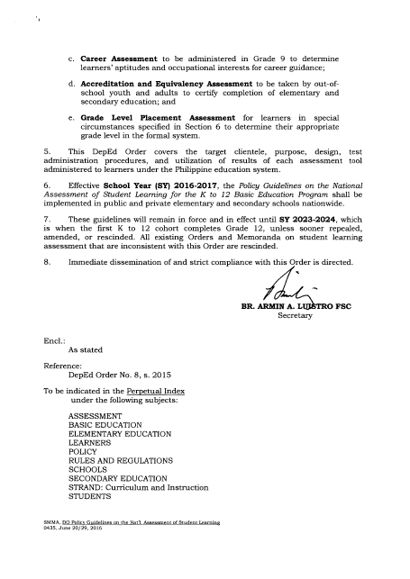
DepED Order 55, s. 2016, Section 4 – Career Assessment

Slide 3
Rationale
In order to guide the conduct of career guidance at the school level and to ensure the development of skills and competencies required in the world of work, DepEd shall conduct a career assessment through the Bureau of Education Assessment (BEA) to Grade 9 students beginning School Year 2016-2017.

Slide 4
Specific Objectives
To provide guidance to individual learners for their future educational and career choices; and
To provide a basis for profiling learners’ aptitude in the four Senior High School Tracks:
a. Academic
i. Accountancy, Business, Management (ABM)
ii. Science, Technology, Engineering and Mathematics (STEM)
iii. Humanities and Social Sciences (HUMSS)
b. Technical-Vocational-Livelihood
c. Sports
d. Arts and Design

Slide 5
Domains Measured
A. General Scholastic Aptitude (GSA)
is the average of the standard scores in these areas:
Scientific Ability
Reading Comprehension
Verbal Ability
Mathematical Ability
Logical Ability

Slide 6
B. Occupational Inventory Interest (OII)
Is an inventory/checklist of occupational interests which provides an assessment on inclinations/preferences for comprehensive career guidance. A profile chart of the students’ occupational inclinations and preferences through the identified cluster occupations is provided.

Slide 7
C. Aptitude for Senior High School (SHS) Tracks
Measures the innate ability or potential of a student to succeed in the following SHS Tracks:
Academic- ABM, STEM, HUMSS
Technical-Vocational-Livelihood
Sports
Arts and Design

Slide 8
Target Clientele
The test shall be administered to all Grade 9 learners who are currently enrolled in public schools and private schools with a government permit or recognition.
Learners with special needs may also be assessed provided that test accommodations are met.
(Refer to DO. 55, s. 2016 Sec. 9)

Slide 10
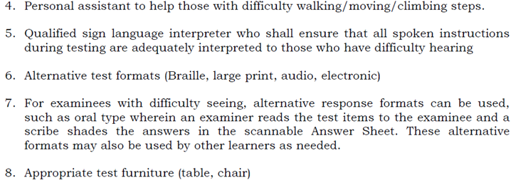

Slide 11
Mode of Administration
Census will be the mode of administration
Schedule of Administration
The test shall be administered annually every last Wednesday and Thursday of August.

Slide 12
Test Administration Scheme
The test shall be administered in two days.
Day | Booklet Number | Test Domain
1 | 1 | General-Scholastic Aptitude
 |  | Technical-Vocational-Livelihood
 |  | Sports
2 | 2 | Academe
 |  | Occupational Interest
 |  | Arts and Design

Slide 13
Number of Examinees per Testing Room
30 examinees per room
Alphabetically arranged regardless of gender

Slide 14
Test Results Interpretation
Test results shall be recommendatory.
The career choice of the student based on his/her aptitude and occupational interest shall prevail as facilitated by the guidance counselor/teacher and as guided by the trends in the labor market.

Slide 15
Test Results Utilization
Reporting and interpretation of the results shall be used in career advocacy, career guidance and homeroom guidance.
It can be used for entry assessment to the specific Senior High School (SHS) tracks/strands in all public and private schools.

Slide 16
Prior to entering SHS, the aptitude of students in select programs shall be measured in order to ensure that they have the potential to complete the program.
The Certificate of Ratings (CORs) shall include a report on the students’ General Scholastic Aptitude, Occupational Interest Inventory (with first and second preferences), and the track they opt to pursue vis-a-vis their aptitude in the SHS tracks.
Results shall be reported in Standard Scores and Percentile Ranks.

Slide 17
Cut-Off Score
There is a required cut-off score for students who wish to enroll in the Science, Technology, Engineering, and Mathematics (STEM) Strand.
The final grade both in Science and Math in Grade 10 should be 85 and above.
Learners should also have at least a percentile rank of 86 and above in the STEM subtest.

Slide 18
However, there will be no prescribed cut-off score for the scholastic grades and scores in any subtest for those who desire to enter into the HUMSS and ABM Strands, and the TVL Track.

Slide 19
Screening of Students (Sports, Arts and Design Tracks)
There will be two screenings for students who wish to enroll in the Sports and Arts and Design Tracks.
The first screening will be the results of the NCAE in the corresponding subtests. Aptitude should be at least a percentile rank of 51 and above.
The second screening for the Sports Track will be done through skills-related fitness tests, while for the Arts and Design Track, it will be through a performance and skills assessment. Both screenings will be administered by the accepting schools.

Slide 20
Table 1. Criteria for entry to senior high school (SHS) tracks/strands
 | SHS Tracks/Strands
Criteria | Academic Track |  |  |  | Sports Track | Arts and Design Track | TVL Track
 | STEM Strand | ABM Strand | HUMSS Strand | General Academic Strand
Scholastic Grades at Grade 10 | Final Grade no lower than 85 both in Math and Science | None | None | None | None | None | None
Career Examination Results | Percentile rank of 86 and above in the STEM subtest | None | None | None | Percentile rank of 51 and above in the corresponding career subtests |  | None
Alternative Entry Requirements | Write up of scientific inquiry process, draft experiment, and other such summative assessments | Simple business concept/idea, marketing ideas, and other such summative assessments | Essay on current social issues, short story or articles, book/movie reviews, and other such summative assessments | Essay on a project of interest, project plan, and other summative assessments | Skills-related fitness tests administered by the accepting schools | Performance and skills assessment administered by the accepting schools | Livelihood project idea/s, and other such summative assessments
Accepting schools shall administer alternative entry requirements as needed.
Schools may also opt to have other alternative assessment aside from those in the table above. These assessments should be in line with their chosen track/strand.

Slide 21
Test Results Dissemination
Test results will be released not more than three months after the examination. Specific test data shall be disseminated to different stakeholders.
Internal Stakeholders
a. Learners
They shall receive individual Certificate of
Rating (COR) that contains the obtained test
scores in the domains and level of
preferences in the occupational fields.

Slide 22
b. School/Division/Region
A report on the Institutional Performance Profile (IPP) or summary of test results by domain shall be released to these offices.
c. Policy makers, program managers, and learning resource developers
A report on the national test results by specific variable shall be provided.

Slide 23
II. External Stakeholders
a. Parents/Guardians
-An orientation forum shall be conducted by the guidance counselor to inform them of the test results and the in-demand and hard-to-fill occupations by industry per region, to guide them in the track or course for senior high school.

Slide 24
b. Academe, community leaders, local government units, non government organizations (NGOs), civil society organizations, legislators, industries, local and foreign donors, researchers, and other government agencies
Test results by specific scope (municipal/congressional and school year) and variable (gender, type of school, etc.) shall be provided upon request.

Slide 25
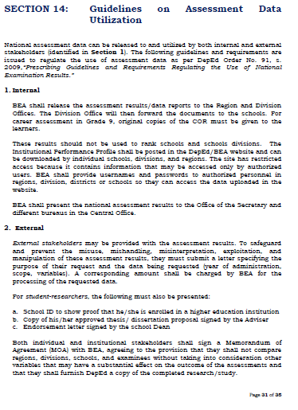
The procedure on the releasing of test results and guidelines on the utilization of national examination results are discussed in D.O. 55, s. 2016 Section 14.

