Slide 1
Step 7: Finalize Improvement Plan
Stage 2: Analyze
Notes:
RECAP the previous two steps. TELL the participants:
The CI steps taught us how to identify the ‘right process problem’ supported by data. It helped in pinpointing the appropriate solution that addresses the root causes of the problem. In this next step, we will learn how to anticipate problems that may arise during the implementation (pilot or rollout) of the recommended solutions.

Slide 2
Analyze – Steps
Do Root Cause Analysis
Develop Solutions
Finalize Improvement Plans
Root Cause Analysis
Common Mistakes in Root Cause Analysis
Types of Root Cause Analysis
Validation of Root Causes
Process Simplification
Visual Management
Good Housekeeping
Mistake Proofing
Idea Generation Technique
Future Process Map
Implementation Plan
Budget and Cost Management Plan
Resource Plan
Risk Management

Slide 3
Learning Objectives:
Understand basic project planning concepts, and consider the activities, resources, and risks involved.
2. Be able plan the implementation of the selected improvement solution.
Notes:
TELL the participants:
In this unit, our learning objectives are:
Understanding basic project planning concepts and consider the activities, resources, and risks involved
Being able to plan the implementation of the selected improvement solution

Slide 4
Key Message
We have to consider POTENTIAL PROBLEMS OR RISKS that we may encounter during the implementation of solutions.
Notes:
TELL the participants:
In this unit, our learning objectives are:
Understanding basic project planning concepts and consider the activities, resources, and risks involved
Being able to plan the implementation of the selected improvement solution

Slide 5
Outline
Implementation Plan
Budget and Cost Management Plan
Resource Plan
Risk Management
Notes:
SHOW the outline slide.

Slide 6
Implementation Plan
Preparing to Pilot
Notes:
INTRODUCE the Implementation Plan

Slide 7
Implementation Planning
Process of Defining and refining tasks and resources required to implement the solutions.
Understand the why.
Plan the work.
Plan the tasks and the subtasks.
Plan the time.
Plan the people and resources.
Understand if it worked.
Notes:
DISCUSS the basic planning requirements.

Slide 8
Implementation Planning
Inputs
Outputs
Tasks and Activities to implement the solution
Key Dates
Detail of work to be done
Timeline
Resources
Duration
Effort
Summary Report
Milestones and Deliverables

Slide 9
Elements of the Implementation Plan
Tasks & Timeline
Budget & Resources
Stakeholders
Expenses
PERSON
Communication
Step
Aug.
Sept.
Oct.
Nov.
Dec.
Jan.
Feb.
or GROUP
& Participation
xxxxx
00.00
Finance
xxxxx
00.00
xxxxx
00.00
Sales
Staff time
IS
Ted
5 hrs
How to
Check
Potential Problems
PLAN
ACTUALS
Step
Pot.
Pot.
Counter-
Change made
Failure
Cause
measures

Slide 10
Planning Tools
Tree diagrams
Planning Grids
Step
Step
Product
Respon-
Due
Whom
Budget/
Other
Number
sibility
Date
to
Cost
Topics
Involve
Flowcharts
Gantt Charts
Sales
Technical
Shipping
Coordinator
Step
Aug.
Sept.
Oct.
Nov.
Dec.
Jan.
Feb.
Notes:
DISCUSS the basic planning tools and highlighting their purpose.

Slide 11
Budget and Cost Management Plan
Notes:
INTRODUCE Budget and Cost Management.

Slide 12
Budget and Cost Management Plan
Project budgets and regular, defined cost management processes are essential to the healthy financial performance of projects
This process will develop the interim and final budget for the implementation of the solution, as well as the plan for when and how expenditures will occur over the lifetime of the solution.
This process also includes establishing the standards and processes for tracking and reporting on-going costs and the implementation budget.
Notes:
DISCUSS the major budget and cost items in relation to key project activities and resource requirements. HIGHLIGHT the one-time cost items versus recurring cost items.

Slide 13
Budget and Cost Management Plan
Cost Estimating – developing an approximation of the costs of the resources needed to complete implementation activities
Cost Budgeting – aggregating the estimated costs of individual activities or work packages to establish a cost baseline
Cost Control – influencing the factors that create cost variances and controlling changes to the project budget

Slide 14
Budget and Cost Management Plan
Inputs
Outputs
Initial target budgets
Implementation Plan
Estimates of work effort by resource and resource costs
Organizational budget and cost tracking standards and processes, including cost accounts and breakdowns
A budget which provides a reasonably accurate picture of how the implementation plans to accrue cost over time
A set of cost management procedures to be used to track financial performance of the implementation and to report against the budget

Slide 15
Resource Plan
Notes:
INTRODUCE Resource Planning.

Slide 16
Resource Plan
Defines the roles, responsibilities, and organizational structure for the implementation of the solution
Identified work requires resources. Resources require an understanding of their roles and responsibility and where their contributions fit within the project. If the resources are not identified at this stage then a plan is needed on how to resolve this situation.
Notes:
DISCUSS how human resource requirements may be determined in relation to solution implementation.

Slide 17
Resource Plan
Inputs
Outputs
Implementation Plan Activities
Staffing Procedures and Standards
Expected contributions and reporting relationships

Slide 18
Resource Plan
If implementation of the solution requires significant time or other resources, your sponsor may want that information included in your plan.
Resources Needed
(Above and beyond normal workload)
RESOURCE/GROUP
REQUEST
•
Information Services support
10 hours/week from June to December
•
Joe and Jane
15 hrs/week for four weeks (dev’p training)
•
All staff
8 hrs each for training course, 2 months
(Need backup)
•
[Etc.]

Slide 19
Resource Plan – Steps
Assess and document the skill and effort requirements to complete the implementation of the solution.
Use the skills and effort requirements from Step 1 to develop the plan for allocating resources to the implementation plan activities.

Slide 20
RISK Management
Notes:
INTRODUCE Risk Management.

Slide 21
Risk Management
Risk Identification
Identify potential problems of your solutions
Risk Assessment
Assess the likelihood or probability of occurring of the risks identified
Assess the consequence, impact or severity of the risk event if it did occur
Establish a risk score and ranking
Notes:
DISCUSS the 4 key components of risk management.

Slide 22
Risk Management
Risk Response Strategy
Determine the best strategy to implement for each risk
Risk Response Planning
developing an action plan or contingency plan for each risk
assigning each risk to a person responsible for tracking and managing the risk
initiating immediate action plan for risks of highest priority

Slide 23
School System and Operational Risks
School Risk Questions:
Major Increase in Costs/Budget needs?
Evolving Student and Community Requirements?
Poor School Performance?
Too long a time table for implementing school changes?
Critical Education System component?
Unclear Fundamental to School Strategy?
Readiness and Commitment of the School?
Notes:
DISCUSS the different possible risks for improvement projects at the school level.

Slide 24
Project Planning Risks
Complex task dependencies?
Critical implementation date?
Informal Project Control Procedures?
Unrealistic implementation target dates?
Low commitment by team and stakeholders?
Resources not available for during implementation?

Slide 25
School and Stakeholder Risks
Unrealistic expectations by regional office, students, parents, teachers, administrators, etc
Significant physical and cultural changes needed by the school?
Resistance to change by the school and its stakeholders?
Extensive training and education of school stakeholders?
Notes:
Tell the participants:
Other Questions:
Impacts both elementary and high school?
Inappropriate level of project support?
Need to do consultations with school stakeholders?
Unavailability school administrators, staff, and teachers?

Slide 26
School External Risk
Poor supplier support?
Project critically dependent outside of School control?
Other projects can impact the school initiative?
Overlapping with other school projects?

Slide 27
Risk Management
Yellow light:
Red light:
Red light:
Proceed with
Address before
Do not Proceed
caution
proceeding
Probability of Occurrence
Yellow light:
Yellow light:
Red light:
proceed with
proceed with
Reassess
Low Medium High
caution
caution
project
Green light
Yellow light:
Red light:
Proceed with
Address before
Caution
proceeding
Low Medium High
Impact on Project
Notes:
TELL the participants:
In doing risk assessment, the probability of a risk affecting a project can range from “yellow light” (low) to “red light”(high). It is the team’s responsibility to identify and assess risks prior to the implementation of a project. Failure to recognize and address a significant risk could jeopardize an entire project.

Slide 28
General Risk Rating Guide
Probability
Major Uncertainties Remain
No Or Little Prior Experience Or Data
Infrastructure and/or Resources Not In Place
Some Uncertainties Remain
Some Experience And Data Exist
Infrastructure In Place But Under-Resourced
Few Uncertainties Remain
Significant Experience And Data Exist
Infrastructure In Place And Fully Resourced
Impact
Performance, Quality, Cost Or Safety Impacts Resulting In Major Redesign And Program Delay
Performance, Quality, Cost and/or Safety Impacts Resulting In Minor Redesign And Schedule Adjustment
Performance, Quality, Cost And Safety Requirements Met Within Planned Schedule
High (5)
Moderate (3)
Low (1)
Notes:
DISCUSS basic guidelines in evaluating the probability and impact levels.

Slide 29
Risk Response Strategy
Avoidance: performing actions to eliminate the cause of the risk.
Transference: transferring the risk to another party such as a contractor or by insurance.
Mitigation: lowering the impact of the risk by reducing the likelihood of occurrence, reducing the consequence, or both.
Notes:
DISCUSS risk response strategy.

Slide 30
Analyzing Risks
Risk Item
Risk Score
Risk Type
Issue: 4th Year students are failing math
Concern: Students are not interested
Consequence: Lost opportunity for student to graduate
Prob Impact Total
3 5 15
Impact
Lo
Hi
1
3
5
Hi
5
5
15
25
Issue: Absenteeism from faculty
Concern: Missed classes by students
Consequence: Incomplete lessons with students
Prob Impact Total
5 5 25
3
3
9
15
Probability
Lo
1
1
3
5
R
Show Stopper
For Each Risk:
Rate Probability Of Occurrence
Rate Severity Of Impact
Categorize Risk Types
O
Significant Risk
Y
Fix Before Production
G
Proceed With Caution

Slide 31
Plan for Mitigating Measures
Risk Item
Risk Score
Plan
Issue: 4th Year students are failing math
Concern: Students are not interested
Consequence: Lost opportunity for student to graduate
Prob Impact Total
3 5 15
Action: Introduce practical examples
Measure: Weekly exams
Owner-Date: Joe - 2/15
Residual Risk: 5
Issue: Absenteeism from faculty
Concern: Missed classes by students
Consequence: Incomplete lessons with students
Prob Impact Total
5 5 25
Action: Review teaching schedule and assignment
Measure: Attendance
Owner-Date: Barbara - 12/15
Residual Risk: 5
Notes:
Tell the Participants:
Develop Risk Reduction Plans:
Identify Specific Actions With Measures Of Success
Assign Owner And Completion Date
Estimate Residual Risk Score (Probability X Impact Remaining After Implementation Of Plan) NOTE: Impact Cannot Be Remediated
Post Plans In Columns Beside Risk Items And Scores

Slide 32
Risk Assessment Format
Notes:
Tell the Participants:
Develop Risk Reduction Plans:
Identify Specific Actions With Measures Of Success
Assign Owner And Completion Date
Estimate Residual Risk Score (Probability X Impact Remaining After Implementation Of Plan) NOTE: Impact Cannot Be Remediated
Post Plans In Columns Beside Risk Items And Scores

Slide 33
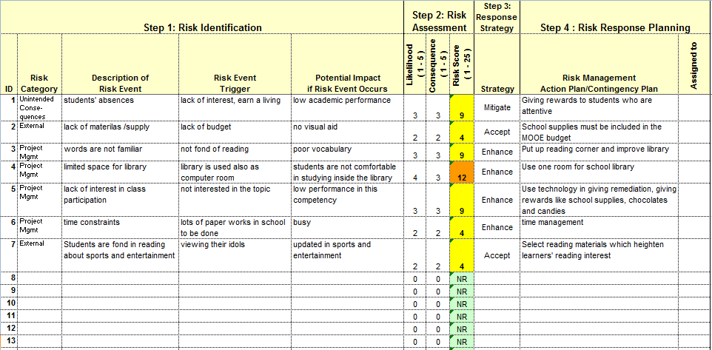
Notes:
Activity 17: Risk Assessment
DISCUSS the Risk Assessment Table (format).
Tell the Participants to:
Develop Risk Reduction Plans.
Identify specific actions with measures of success.
Assign a project owner and a completion date.
Estimate the residual risk score (probability of X impact remaining after the implementation of the plan). NOTE: The impact cannot be remediated.
Post the plans in the column beside the risk items and scores.
ASK the participants to perform a risk assessment.
ASK a representative of the group to present their risk assessment results. When the Improvement Plans are finalized, we can then enter the next phase for out solution – Piloting a test run.

Slide 34
Activity
Conduct a Risk Assessment on each of the solutions generated in the previous exercise.
Notes:
Activity 17: Risk Assessment
DISCUSS the Risk Assessment Table (format).
Tell the Participants to:
Develop Risk Reduction Plans.
Identify specific actions with measures of success.
Assign a project owner and a completion date.
Estimate the residual risk score (probability of X impact remaining after the implementation of the plan). NOTE: The impact cannot be remediated.
Post the plans in the column beside the risk items and scores.
ASK the participants to perform a risk assessment.
ASK a representative of the group to present their risk assessment results. When the Improvement Plans are finalized, we can then enter the next phase for out solution – Piloting a test run.

