Slide 1



The
Philippine Educational Placement
Test:
Frequently Asked Questions
Abelardo B. Medes
Chief
BUREAU OF EDUCATION ASSESSMENT

Slide 2
1. What is PEPT?
The Philippine Educational Placement Test (PEPT), one of DepED-BEA’s testing programs, is under the Accreditation and Equivalency Program.
  It is an equivalency test wherein learning experiences gained out of school are given equivalency and placement in the formal school system by grade level that is appropriate for the examinee’s age and ability.
  This move will encourage him/her to continue and finish basic education and eventually to pursue college education if he/she so desires.

Slide 3
2. Why is PEPT conducted?
To establish that students have met learning standards for specific grade levels
To determine the appropriate grade level of learners in special circumstances in the formal school system
To assess competencies in academic areas gained through informal and nonformal means for entry or reentry into formal school
To assess competencies in academic areas for entry or reentry to formal school
The PEPT is NOT conducted for purposes of grade level acceleration.

Slide 4
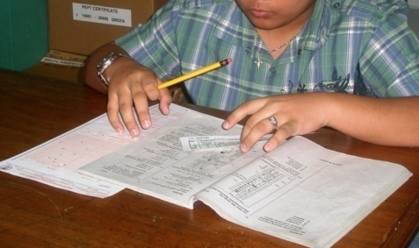
3. Who may take the test?
The target clientele of PEPT or those who may be qualified to take the test are/have:
  from schools without a government permit
  from nonformal and informal education programs
  incomplete or no record of formal schooling
  back subjects
  need grade level standards assessment
  Overage for their grade levels
  Learners with special needs may also be assessed provided that test accommodations as articulated in Section 9 of DO 55, s. 2016 are met.

Slide 5
4. What are the requirements to be submitted prior to taking the test?
  BIRTH CERTIFICATE - issued by the NSO or Local Civil Registrar duly authenticated (original and 2 photocopies)
  ID PICTURES - 2 pieces, identical and recently taken
  (size 1”x1”)
  SCHOOL RECORDS - original and 2 photocopies
    Elementary Level: Form 137 or Form 138
    Secondary Level: Form 137
Form 137: Transcript of Records with school seal and signature of principal/registrar
Form 138: Report Card with school seal and signature of principal/registrar

Slide 6
4. What are the requirements to be submitted prior to taking the test?
  SCHOOL PERMIT - photocopy of School Permit to Operate/Government Recognition (for applicants from private schools)
  REGISTRATION FEE - non-refundable
    Regular administration (every November) - Php50.00
    Walk-in/Special administration - Php200.00

Slide 7
5. How are test applicants screened?
Grade Level Passed / Completed | Normal Age (at the end of the SY) | Age on the Date of Examination | Grade Level to be Tested at starting level)
None (No Schooling) | - | At least 6 years old | Kinder
Kinder | 6 years old | At least 7 years old | Grade 1
Grade 1 | 7 years old | At least 8 years old | Grade 2
Grade 2 | 8 years old | At least 9 years old | Grade 3
Grade 3 | 9 years old | At least 10 years old | Grade 4
Grade 4 | 10 years old | At least 11 years old | Grade 5
Grade 5 | 11 years old | At least 12 years old | Grade 6
Grade 6 | 12 years old | At least 13 years old | Grade 7
Grade 7 | 13 years old | At least 14 years old | Grade 8
Grade 8 | 14 years old | At least 15 years old | Grade 9
Grade 9 | 15 years old | At least 16 years old | Grade 10
Age
  For learners who are overage for their grade level.

Slide 8
5. How are test applicants screened?
Last Level Completed (LLC)
  The LLC is the grade level finished by a test registrant in school.
  In the secondary level, all subjects must have a passing mark including back subjects (if there were) in previous levels as noted in Form 137.
  There should be no pending subject grade in the level in order for it to be considered as the LLC of the registrant.

Slide 9
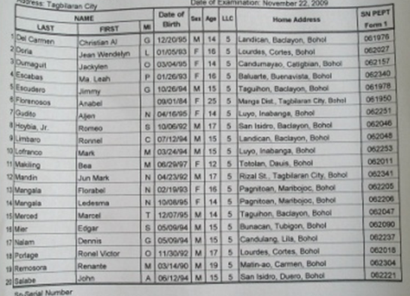
6. Is the test administered based on the examinee’s age and LLC?
Yes
Each examinee is assigned to answer a particular set of test items in the Test Booklet according to his/her age and LLC.
Example #1: a 12-year-old PEPT registrant who finished Grade 2 will be given test items for Grades 3 to 6 on exam day.
Example #2: a 16-year-old registrant who completed Grade 9 level will be given test items for Grade 10 on exam day.
Thus, examinees will have different test time allotments depending on their age and LLC.

Slide 10

7. What is the coverage of the PEPT?
The test is a multiple-choice type assessing 21st Century Skills based on the K to 12 Curriculum
Elementary Level:
  Science
  Mathematics
  Araling Panlipunan
  Filipino
  English

Slide 11
7. What is the coverage of the PEPT?
Secondary Level:
  ENGLISH – Reading Comprehension, Vocabulary Development, Writing Composition, Literature (Philippine, Asian and World), Grammar Awareness
  SCIENCE – General Science, Biology, Chemistry, Physics
  MATHEMATICS – Numbers and Number Sense, Measurement, Geometry, Patterns and Algebra, Statistics and Probability
  FILIPINO – Gramatika, Panitikan (Ibong Adarna, Florante at Laura, Noli Me Tangere, El Filibusterismo)
  ARALING PANLIPUNAN – Araling Asyano, Kasaysayan ng Daigdig, Ekonomiks, Current Trends and Issues

Slide 12
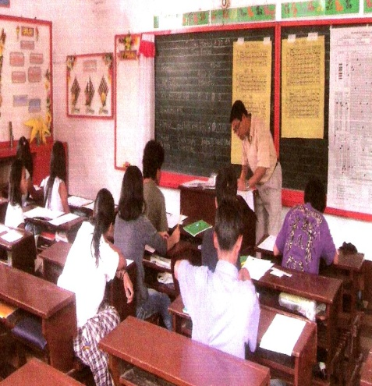
8. When could PEPT be availed?
  Nationwide Testing
    Administered annually every November in designated Testing Centers in DepED provincial and city divisions
    Luzon - every third Sunday of November
    Visayas and Mindanao - every fourth Sunday of the same month
Walk-in Examination
  Administered at BEA from
  January to December

Slide 13

8. When could PEPT be availed?
Special Examination
  It is conducted for specific purposes as per request of concerned parties. It shall be held four times a week and year-round on a first-come-first-served basis.
  The approval and venue of the
  special exam depends on the
  necessity of the said request.

Slide 14

9. How does one register for the PEPT?
  Nationwide Testing
  Test applicants should register
  at the nearest Division Office
  from August 1 to September 30.
  A report on the total number of registered applicants in every testing center in the division shall be submitted to BEA by the DTC on or before October 1 for test materials allocation.

Slide 15
9. How does one register for the PEPT?
Walk-in Examination
  Prospective test takers should personally register at BEA’s Education Assessment Division (EAD)
  2nd Floor, Bonifacio Bldg., DepED Complex, Meralco Avenue, Pasig City
  Contact Numbers: 631.2571 / 631.2591 / 631.6921
Special Examination
  Interested parties should coordinate with the Office of the BEA Director (same address and contact numbers; email: bea.od@deped.gov.ph)

Slide 16
10. What is a testing center? What are the requirements in putting up one?
  A testing center is a public school designated by the SDS which is most accessible to the majority of the registrants. The testing center requirements are found in Section 8 of DO 55, s. 2016;
A sub-center to an existing testing center may be opened upon request provided that:
  the number of registrants is at least fifty (50);
  the location of the proposed sub-center is far from the existing testing center; and
  the request is submitted to BEA on or first week of September

Slide 17
11. How are test results processed?
  SCANNING MACHINE
    Each scannable Answer Sheet used by an examinee is scanned by a machine.
    As the examinee is assigned a particular set of test items to answer based on his/her age and LLC, the answers to these items are processed electronically.

Slide 18
12. How are test results analyzed and interpreted?
  RATING SYSTEM
    Examinees must obtain a rating of at least 75% in all subject areas in one grade level in order to pass it. If they obtain a passing rate in all subjects, they are considered as a qualifier in the said level.
    Examinees may pass as many levels with their age as ceiling, meaning they may qualify only up to the school level appropriate for their age.
    Averaging of subject area scores is not the rating system of PEPT.

Slide 19
13. How are test results analyzed and interpreted?
  NORMS
    The PEPT is a norm-based test; an examinee’s test performance is compared to the norm.
    This means that a PEPT passer’s ability in a certain grade level equally conforms to that of an average school-aged child/youth in the same level.
    For instance, a PEPT Grade 7 qualifier is expected to equate in performance with that of an average Grade 7 student.

Slide 20
14. What if the examinee failed one subject, can the ratings in 5 subjects be averaged?
  No
  Ratings in 5 subject areas are not averaged
  However, examinees whose test score in one subject is lower than 75% may be allowed to retake the failed subtest within six months

Slide 21
15. How do examinees get their test results?
  A PEPT Certificate of Rating (COR) is issued to each individual examinee.
  The release of test results is done in specific schedules:
    Nationwide Testing – from February to March; CORs are sent to Division Offices
    Walk-in Examination – one month from the date of exam; CORs are picked up at BEA
    Special Examination – CORs will either be sent to or picked up by the requesting party one month from the date of exam

Slide 22
16. What if an examinee lost his/her COR? Will BEA issue another copy?
Yes.
The re-issuance of PEPT Certificate of Ratings (COR) costs fifty pesos (Php50.00).
  Same rate applies in the re-issuance of NCAE CORs.
For those who are in Metro Manila
  Proceed to DepED-BEA, Verification Room, 2F Bonifacio Bldg, DepED Complex, Meralco Avenue, Pasig City (Mon-Fri, 8 AM-5 PM) and fill out the Request Form (next slide).
For those who are outside Metro Manila
  Send BEA a letter of request (fax or email)* with the filled out Request Form to help locate the test results in its database.
  Include a contact information in order for us to advise you on the next procedure (payment).
  *BEA Fax Number (02-6316921) and Email (bea.od@deped.gov.ph)

Slide 23
PEPT COR Request Form
NAME: (Surname, First Name, Middle Name)
COMPLETE ADDRESS:
CONTACT NUMBER:
DATE OF EXAMINATION: (Day, Month, Year)
PLACE OF EXAMINATION: (Testing Center, Division, Region)
PURPOSE OF REQUEST: Employment Evaluation
Signature of Applicant Date

Slide 24
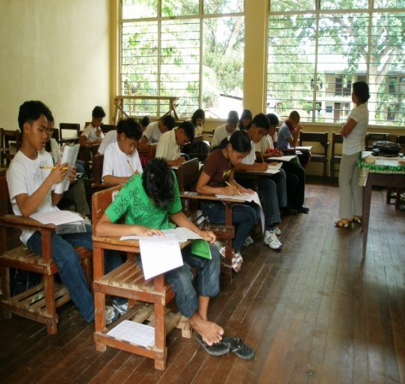
17. When can examinees use the PEPT results?
  PEPT- Regular/Special: The test results shall be utilized or will be in effect in the subsequent school year and not during the school year when the test was taken.
  PEPT – June 12: The results shall take effect within the school year.

Slide 25

18. Can the PEPT be administered to examinees with special needs?
  Yes
  Individuals with Visual Impairment (VI)
    The PEPT has a Braille test form in the
    elementary and secondary levels
    For Braille readers, they have to use their own slate and stylus in recording their answers
    BEA will provide the Answer Sheets/papers
    1 Examiner : 3-5 Examinees
    Separate testing room
    Examiner will use a Special Handbook in administering the test
    Time allotment is different from a regular examinee

Slide 26
  Individuals with Visual Impairment (VI)
    For non-Braille readers, an alternate test form is given
    1 Examiner : 1 Examinee
    Separate testing room
    Test items are read and answers are recorded by the examiner
    Special test booklet with modified test items
    Regular scannable answer sheet

Slide 27
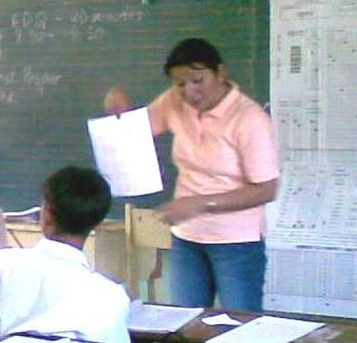
  Individuals with Hearing
  Impairment (HI)
    They may be merged into the
    regular testing room
    Separate sheet with instructions will be provided for pre-testing activities/directions
    Examiner has to be certain that instructions were understood by the examinee prior to the test proper

Slide 28
Additional information for Test Accommodations for Learners with Special Needs can be read in Section 9 of DO 55, s. 2016

Slide 29


End of Presentation
PEPT Slogan:
Tuloy-Aral Tungo sa
Magandang Kinabukasan

