Slide 1
Step 2:Talk with your Customers
Stage 1: Assess
Mabinay National High School Division Rollout of the CIP Project Oct. 22-24, 2015
Notes:
TELL the participants:
In this unit, our learning objectives are:
Understanding the concept of VOC.
Being able to obtain information on VOC using basic data collection and analysis methods.

Slide 2
Objectives:
1. Understand the concept of VOC.
2. Be able to get information on VOC using basic data collection and analysis methods.
Mabinay National High School Division Rollout of the CIP Project Oct. 22-24, 2015

Slide 3
Assess – Steps
Get Organized
Talk with Your Customers
Walk the Process
Identify Priority Improvement Areas
Evaluation of School Performance
Project Selection Criteria
Challenges of CI Projects
CI Project Template
School Based CI Organizational Structure
Voice of the Customer
Techniques for gathering VOC
Guidelines for Survey question construction
Affinity Diagram
Problems with processing VOC
SIPOC
Process Mapping
Flowcharting
Walk the Process Guidelines
Situating the Storm Cloud
Data Collection
Data Collection Plan
Data Analysis
Selecting the Focused Problem Statement
Notes:
TELL the participants:
The Assess Stage involves forming a team, talking to your customers, and describing our current process.
DISCUSS the elements of forming a CI team.
HIGHLIGHT the importance to identify the customers' needs.
EMPHASIZE that the process to be mapped is the AS-IS process (the AS-IS status is not always reflected in what is documented).
DISCUSS the importance of data in identifying the priority area.

Slide 4
Outline
Voice of the Customer
Techniques for gathering VOC
Guidelines for Survey question construction
Affinity Diagram
Mabinay National High School Division Rollout of the CIP Project Oct. 22-24, 2015

Slide 5
Key Message
A Customer-Focused Organization understands the requirements of their customers and measures how well these requirements are met.
Mabinay National High School Division Rollout of the CIP Project Oct. 22-24, 2015

Slide 6
Voice of the customer
Mabinay National High School Division Rollout of the CIP Project Oct. 22-24, 2015
Notes:
Tell the participants:
These are the positive feedback and concerns of the customers regarding our process' services and output.

Slide 7
What is VOC?
A qualitative statement or phrase in the Customer’s language of their needs and wants.
Mabinay National High School Division Rollout of the CIP Project Oct. 22-24, 2015
Notes:
TELL the participants to:
Relate and classify their answers from slide 6 according to the different types of customers.

Slide 8
Who are your customers?
Individuals or groups who receive the concept or service
Mabinay National High School Division Rollout of the CIP Project Oct. 22-24, 2015
Notes:
Tell the participants:
Generate the customers of the different identified processes from “Get Organized”.

Slide 9
VOCs can mean Needs or Wants
Needs
Wants
These are what customers expect to receive from a concept or service
This is a preference of a customer on how to receive a concept or service
We need both Wants and Needs to create balance on what and how!
Make sure to address the Needs first before Wants!
Notes:
EMPHASIZE to the participants:
Needs are more likely common across your customers.
Wants may vary from customer to customer even if they share the same needs.
Edited this for consistency.

Slide 10
Understanding VOCs
Stated Needs
Real Needs
“I need access to the internet”
“I need to have a projector inside the classroom”
“I need to have new teaching materials”
“I need to have the entire class see the teaching materials”
Mabinay National High School Division Rollout of the CIP Project Oct. 22-24, 2015
Notes:
TELL the participants:
When identifying customer needs, several issues may arise. The points illustrated in slides 9-11 are just a few issues that customer research has to address.

Slide 11
Understanding VOCs
Perceived Needs
Actual Needs
“I want an understanding teacher”
“I need a computer”
“We need books in the library”
“I need to have a strict teacher
“I need a calculator”
“We need a place for students to study”
Intended Usage
Actual Usage
Mabinay National High School Division Rollout of the CIP Project Oct. 22-24, 2015

Slide 12
Guidelines on transcribing Parents/Students/Teachers VOC
The statements used should be in the parents, students, and/or teachers own language as much as possible.
To get these statements:
Read through interview notes, survey notes, comment cards, etc.,
Highlight any statements you think are relevant to your project.
Mabinay National High School Division Rollout of the CIP Project Oct. 22-24, 2015
Notes:
TELL the participants to:
Transcribe the strongest of these statements on cards or self-stick notes that you can use for the affinity diagram.

Slide 13
Techniques for gathering VOC
Mabinay National High School Division Rollout of the CIP Project Oct. 22-24, 2015
Notes:
INTRODUCE Techniques for Gathering VOC.

Slide 14
Gathering VOC
Qualitative:
The collection of data or information (by verbal, visual, tactile, olfactory, and gustatory means) that provide a detailed description of a situation, community or problem as the basis for developing an analysis.
Notes:
Tell the participants:
Qualitative VOC is used to understand what, why, how, where and when.
Qualitative VOC:
Is open-ended, dynamic, and flexible.
Deeply understands the customers' needs.
Considers a small base size and is not projectable.
Can tap customer creativity and individual responses.
Can penetrate rationalized or superficial responses.
Is rich in sources of ideas for new concepts or concept improvements.

Slide 15
Methods for Gathering Qualitative Data
Interview
One-on-one, Pair (Dyad), Triad
Focus Group Discussion (FGD)
Observational
home visits
classroom visits
Play area visits
Mabinay National High School Division Rollout of the CIP Project Oct. 22-24, 2015
Notes:
TELL the participants:
One-on-one, Dyad/ Paired, or Triad Interviews are ideal for understanding complex matters, personal issues, emotionally charged topics, or decision-making processes.
Dyads and Triads are conducted when a one-on-one setting is too intimidating for the respondent. This is usually conducted among kids and teenagers, along with their friends and playmates.
Focus Group Discussions (FGD) are ideal for brainstorming and exploring broad concepts and directions.

Slide 16
Uses of Focus Group Discussion
Organize information from the collective point of view of a group of customers
To clarify and define customer needs
To gain insights into the prioritization of needs
Mabinay National High School Division Rollout of the CIP Project Oct. 22-24, 2015
Notes:
TELL the participants:
VOCs can also be collected during the solution stage in order to test concepts and get feedback.

Slide 17
Things to avoid in constructing Interview Questions
Closed-ended questions. Have a follow up question when necessary.
Loaded questions
Over specificity of questions
Ambiguous wording
Unstated criteria
Over emphasize
Leading question
Example containment
Mabinay National High School Division Rollout of the CIP Project Oct. 22-24, 2015
Notes:
Activity: Identifying BIAS in Questions
SHOW the sample questions.
TELL the participants: In your table teams, identify the bias in the questions above. Be prepared to report your team's findings to the entire group.
ASK a representative per group to report their conclusions.

Slide 18
Other Forms of Qualitative Research
Bringing us closer to our customer:
Home visits
Classroom observations
Buddy panels / adult panel interviews
Diaries - video; written; audio; drawing
Conversations with experts / third parties
Mabinay National High School Division Rollout of the CIP Project Oct. 22-24, 2015
Notes:
TELL the participants about the other forms of Qualitative research:
Home Visits - The researcher goes to respondent’s home and observes the practices of the respondent. The respondent is fully aware that he/ she is being observed.
Classroom Observations (Natural Environment) - The researchers observe their customers in a natural environment (i.e. where purchase decisions are made, where customers spend most of their time). Usually, the respondents are not aware that they are being observed.
Buddy Panels/ Adult Panels - An ongoing panel among customers; the respondents come in pairs wherein one is a moderator and the other is a co-moderator. This technique is effective among kids and teens because it is less intimidating and more fun. The Buddy panel is also effective in rapid concept/ prototype development. This allows researchers to establish a more intimate relationship with the customers and gain more insights about their lifestyles, feelings, and attitudes. This technique can also be conducted on adults.
Diaries - This is effective in rapid concept/ prototype development. The use of diaries allows researchers to understand behavioral changes in the adoption of a new idea.

Slide 19
How Tools Can Be Used Together
Conduct personal (one on one) interviews with the customers to help identify and list what they really need and want
FGD or observational groups to obtain deeper and more refined understanding
Dyads or Triads to obtain capture desired “outcomes” deeper and more refined understanding
Surveys to quantify and verify
Mabinay National High School Division Rollout of the CIP Project Oct. 22-24, 2015
Notes:
TELL the participants:
In most cases, tools need to be used in combination. Tools used in combination move you from one level of certainty to the next.

Slide 20
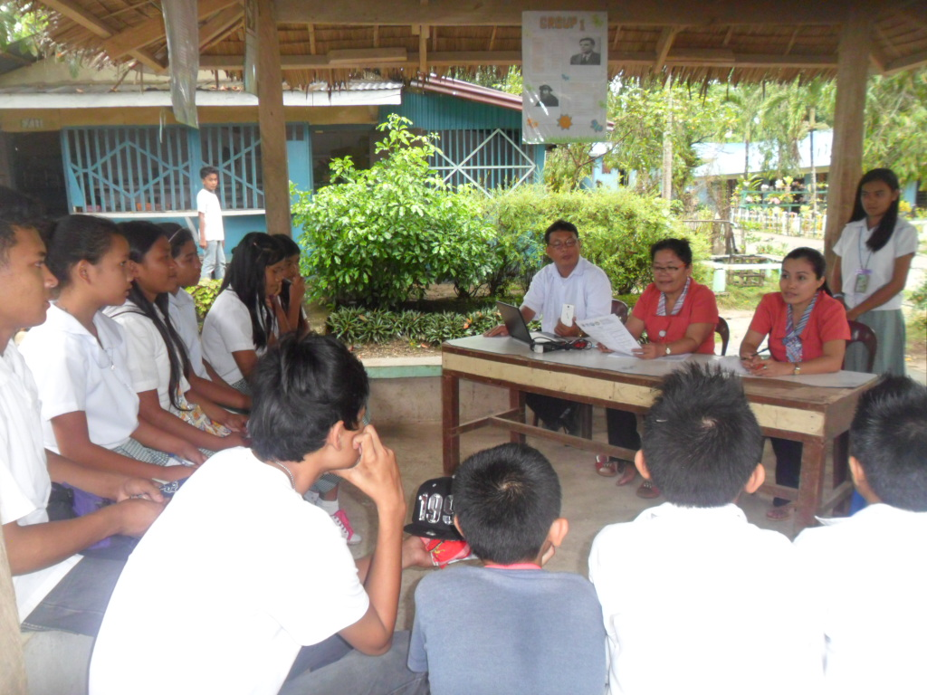
CI MEETING Voice of the Customer (Students) October 27, 2014
Mabinay National High School Division Rollout of the CIP Project Oct. 22-24, 2015

Slide 21
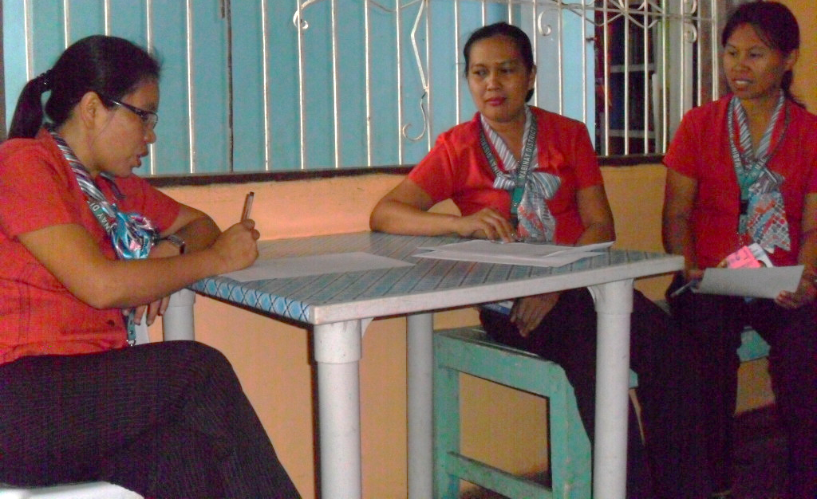
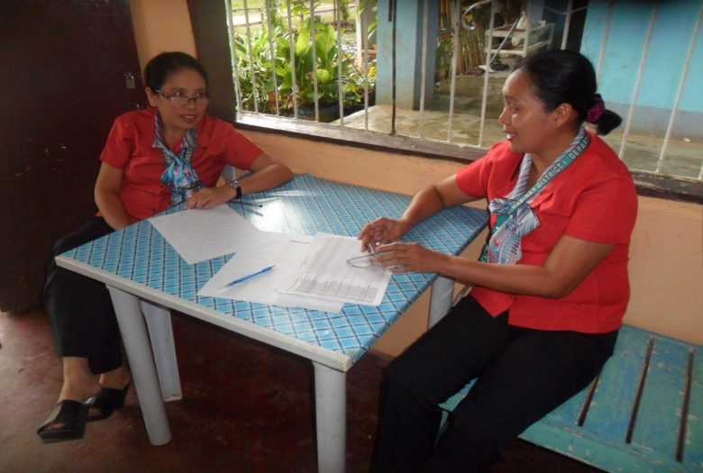
CI MEETING Voice of the Customer (Teacher) October 27, 2014
Mabinay National High School Division Rollout of the CIP Project Oct. 22-24, 2015

Slide 22
Affinity Diagram
Mabinay National High School Division Rollout of the CIP Project Oct. 22-24, 2015
Notes:
INTRODUCE the Affinity Diagram.

Slide 23
Affinity Diagram
When Gathering large amounts of language data:
Help grasp very large or complex issues
Find patterns in mountains of data
Organize ideas, issues, opinions
Encourage breakthrough understanding
Mabinay National High School Division Rollout of the CIP Project Oct. 22-24, 2015
Notes:
TELL the participants:
Organizing language data to find patterns is just as important as organizing numerical data. The more data you have, or the more complex the problem, the more important it is to organize this data in a meaningful way. When we read unsorted statements, it is easy to create meaning by filtering the data through our own biases. By sorting the statements, we get a more objective view of themes and patterns.
The affinity diagram process involves the whole group, which helps to increase the buy-in from individual group members. More importantly, the group process helps cancel out individual biases.

Slide 24
Affinity Diagram (Getting Value from VOC Data)
Theme 1
Need 1
Need 2
Theme 3
Theme 2
Need 6
Need 3
Need 4
Need 7
Need 5
Notes:
Tell the participants:
Unlike other data tools, the creation of an affinity diagram stresses creative or intuitive thinking more than logical thinking.
The first step in getting value from customer data is organizing it in a way that will reveal themes
An affinity diagram is a good tool for this purpose since it organizes language data into related groups
The affinity diagram involves the whole team, which helps to increase buy-in from individuals

Slide 25
Problems with processing VOC
Notes:
DISCUSS the problems with processing the VOC.

Slide 26
Problems with Processing VOC
Difficulty in translating what the customer is saying to what we should be measuring.
Possible Reasons:
The VOC are biased
The VOC are ambiguous to us.
The VOC can have many meanings.
VOC are not expressed as a true need
Needs versus wants
VOC from the wrong customers
Mabinay National High School Division Rollout of the CIP Project Oct. 22-24, 2015

Slide 27
VOICE OF THE CUSTOMERS
Learners
Subject Teacher
Parents
Mabinay National High School Division Rollout of the CIP Project Oct. 22-24, 2015

Slide 28
VOICE OF THE CUSTOMERS
(Learners)
Unsay imo ikasulti sa mga questions, lisod o sayon?
(What can you say about the questions, are they difficult or not?)
Answers:
-Lisod kaayo kay dili man ko kasabot sa ubang words.
-Sayon pod ang uban labi na tong nahinumduman ra namo.
Nganu man nga uban ninyo ni answer man ug D nga wala man ni sa choices?
(Why did you answer letter D when it’s not found in the choices?)
Answers:
Patakaan ra man namo ug answer kun dili mi kasabot.
Mabinay National High School Division Rollout of the CIP Project Oct. 22-24, 2015

Slide 29
Nagbasa ba ka sa instruction sa exam ug sa kada pangutana?
(Did you read the instructions of the exam and each of the given questions?)
Answer:
-Gibasa apan gamay ra ang masabtan kay English man.
Paghuman nimo ug answer imo paba gi review imo answer?
(After answering did you review your answer?)
Answer:
- Wala na.
Unsa kasagaran ang gigamit sa imong maestra sa pagtudlo sa inyo subject nga math?
(What did your teacher use when she teaches your math subject?)
Answer:
- Manila paper, cartolina
Mabinay National High School Division Rollout of the CIP Project Oct. 22-24, 2015

Slide 30
Sa four basic operations (addition, subtraction, multiplication,division) asa may pinaka lisod/pinaka sayon para nimo? Ug nganu man?
( Of the four basic operations, what is the easiest / the most difficult for you? Why? )
Answers:
-Ang pinakasayon para nako mao ang addition, ang pinakalisod mao ang division.
-Para nako sayon ra ang addition ug subtraction, lisod ang multiplication ug division
Mabinay National High School Division Rollout of the CIP Project Oct. 22-24, 2015

Slide 31
VOICE OF THE CUSTOMERS
(Teacher)
How would you describe the performance of your students?
Answers:
-Most of the students are in the developing level.
-They cannot answer HOTS questions.
-They cannot understand English.
-They lack focus and has no retention
What do you usually use as instructional materials?
Answers:
-Manila Paper
-Cartolina
What interventions have you implemented?
Answers:
-I have done remediation activities but very seldom
-Carry out cooperative learning activities at times

Slide 32
VOICE OF THE CUSTOMERS
(Parents)
1.) Kumusta man ang inyong mga anak sa ilang pagtuon o pag eskwela sumala sa inyong nakita sa balay?
(How are your children in their studies or schooling based on what you’ve observed at home?)
Mga tubag:
Dili ok ang akong anak kay sige ra ka late, dili tig tuon, sige ra salaag.
Lisuran ang akong anak sa ubang leksyon, ang uban sayon ra sab.
Dili ok ang akong anak kay dili mapalit ang ubang gamitonon sa eskwelahan tungod sa kakulang sa budget.
Mabinay National High School Division Rollout of the CIP Project Oct. 22-24, 2015

Slide 33
VOICE OF THE CUSTOMERS
(Parents)
2.) Naka follow up ba ka sa iyang mga buluhaton sa eskwelahan? Kung naka follow up man, unsay imong gibuhat? Kung wala, unsa may rason?
(How you made some follow-ups with your students’ school works? If yes, what have you done? If no, what’s your reason?)
Mga tubag:
Wa naka followup kay busy ang mama sa pagpangeta ug trabaho og negosyo, busy pod ang anak sa pag sige ug drawing2x.
Di maka follow-up kay nag abang lang ang anak sa lungsod ug talagsa lang mouli sa ilang balay.
Ang pag follow-up igo lang sa pagpangumusta, di jud tan-awon kun unsa ang gitun-an sa anak.
Mabinay National High School Division Rollout of the CIP Project Oct. 22-24, 2015

Slide 34
VOICE OF THE CUSTOMERS
(Parents)
3.) Unsa man orasa kasagaran mouli imong anak sa inyong balay?
(What time does your son/daughter usually arrive home?
Mga tubag:
Kasagaran 6pm na mauli akong anak kay mag research pa daw siya ( dala dula2x) .
Akong anak sayo ra mauli sa balay kay may schedule man sya ug trabaho sa balay.
Di’ kada adlaw makauli akong anak kay nag abang raman ug pinuy-anan diri sa Poblacion, layo man
among balay.
Mabinay National High School Division Rollout of the CIP Project Oct. 22-24, 2015

Slide 35
VOICE OF THE CUSTOMERS
(Parents)
4.) Unsa man kalayo ang inyong pinuy-anan sa iyang eskwelahan?
(How far is your house from his/her school?)
Mga tubag:
Di ra kayo layo kay naa ra sa purok 3 sa Poblacion amo pinuy-anan.
Ang uban naa ra sad sa purok 6.
Ang uban naa sa Gumatos, Pandanon, mga 7 km ang gilay-on gkan sa eskwelahan.
Ang uban nagpuyo sa Capipines sakop sa Bindoy, mga 12 km gkan sa eswkelahan.
5.) Maglakaw raba siya o magsakay paingon sa eskwelahan ug papauli sa balay?
(How did he/she travel from home to school and vice versa? Did he/she walk or ride?)
Mga tubag:
Maglakaw ra para makadaginot sa budget.
Kuhaon ug motor.
Maglakaw ra jud ma hapon bisan gihatagan ug plete.
Mabinay National High School Division Rollout of the CIP Project Oct. 22-24, 2015

Slide 36
VOICE OF THE CUSTOMERS
(Parents)
6.) Pag-abot niya sa inyong balay unsa may lagmit o kasagaran niyang buhaton?
(When he/she arrived home what does he/she usually do?)
Mga tubag:
Mangluto o maglung-ag para panihapon.
Manghugas sa kinan-an.
7.) Tigpatabang ba siya pagbuhat sa iyang mga assignments ug projects? Ngano man? Ug nganong dili sab?
(Did your student ask you to help him/her with his/her assignments and projects? Why or why not?
Mga tubag:
Di ra magpatudlo kay sayon ra daw ang iya lessons.
Di na pasugo sa balay kay daghan daw sya tun-anan.
Maulahi ang trabaho sa balay kay unahon ang leksyon.
Magtuon siya siya ra.
Walay mahimo ang ginikanan kay wala silay ikatudlo , walay ika-share kay kulang iniskwelahan ang ginikanan.
Sa igsoon lang papangutan-on kabahin sa nalibgan
Mabinay National High School Division Rollout of the CIP Project Oct. 22-24, 2015

Slide 37
VOICE OF THE CUSTOMERS
(Parents)
8.) Unsa man ang mga pwede mabasa o matun-an nga anaa sa inyong balay?
(What materials are available for reading and studying at home?
Mga tubag:
Dictionary
Bible
Encyclopedia
Mga libro gikan sa school
Ang uban walay laing mabasa sa balay
9.) Nakakita ba ka nga nagtuon imong anak sa inyong balay? Unsa man kasagaran nga subject iyang tun-an?
(Have you seen your son/daughter studying at home? What subjects are usually studied?)
Mga tubag:
Wa ko masayod kay di ra pod tigtuon ang akong anak.
Tigtuon ra.
Wa rapod ko ka followup.

Slide 38
VOICE OF THE CUSTOMERS
(Parents)
10.) Kun nakita nimo nga wala siya magtuon sa inyong balay sa iyang mga subjects, unsay imong gibuhat?
(What do you do when you see that your son/daughter is not studying at home?)
Mga tubag:
Patun-on ang anak apan di maminaw, mulakaw ra kun storyahan, di maminaw.
Sultian ang anak nga patun-on.
11.) Tig tan-aw ba ug TV ang inyong anak? Kun tig tan-aw sya, unsa kasagaran ang iyang tan-awon nga mga salida, English o Tagalog?
(Is he/she fond of watching TV? If yes, what does he/she usually watch, English or Tagalog?)
Mga tubag:
Kasagaran Tagalog, usahay English.

Slide 39
VOICE OF THE CUSTOMERS
(Parents)
12.) Unsa nga klasi sa mga salida iya tan-awon?
(What kind of TV shows did he/she watch?)
Mga tubag:
Kasagaran mga cartoon movies.
13.) Aduna ba syay kaugalingon nga mga gadgets?
(Does he/she have his/her own gadgets?)
Mga tubag:
Cellphone lang.
Ang uban wala jud bisan cellphone lang.
14.) Kabahin niining atong Continuous Improvement Program (CIP), andam ba ka mosuporta sa imong anak para matabangan cya? Sa unsang paagi?
(About this Continuous Improvement Program (CIP), are you ready to support your student so that he/she will be helped? In what way?)
Mga tubag:
Andam ra mi sa pag suporta basta alang sa kaayohan sa among mga anak.
Ok ra basta naa ra sa sulod sa eskwelahan ang pangbuhaton.

Slide 40
Voice of the Customers (Students)
Sample of Affinity Diagram
I don’t exert effort
I don’t understand the questions
I want teachers with varied activities
Nobody can help us reinforce the lessons at home
I need a classroom conducive to learning
Wa kuyawi
Wa basaha
Wa mangutana sa titser kay maulaw
Subjects nga di ganahan talagsa tun-an
Diretso answer way basa-basa
Wa kasabot sa meaning sa words
Ubang items lisod sabton
Kun di ko kasabot patakaan ra ug answer
Nalimot na sa 4 fundamental operations
Dili ko maayong mobasa kay English man
Ganahan ko naay games
Gusto ko sadya
Ganahan ko lain-lain ang activities
Ganahan ko nga ang akong titser mopasiaw
Nagpreperar ug pagkaon
Nagboard ra man ko, usahay makatabang ang boardmate, usahay dili
Init among classroom
Ngit-ngit labi pag mag brown-out
Naghu-ot mi sa among classroom
Mabinay National High School Division Rollout of the CIP Project Oct. 22-24, 2015

Slide 41
Activity
Mabinay National High School Division Rollout of the CIP Project Oct. 22-24, 2015
Notes:
Activity 09: VOC and Process Measures
SHOW the VOC responses.
ASK the participants to identify the responses' themes and group similar responses together. ASK a representative per group to present their conclusions.
SHOW a possible affinity solution.
ILLUSTRATE a Tree Diagram.
ASK the participants to use the tree diagram to identify process measures.
ASK a representative per group to present their conclusions.

Slide 42
What to do?
Construct possible questions for your target beneficiaries/customers
Give probable answers to questions created
Mabinay National High School Division Rollout of the CIP Project Oct. 22-24, 2015

Slide 43
Remember!
A Customer-Focused Organization understands the requirements of their customers and measures how well these requirements are met.
Mabinay National High School Division Rollout of the CIP Project Oct. 22-24, 2015
Notes:
HIGHLIGHT the importance of customers.
After thoroughly understanding the customers' needs, we can then proceed to flesh out the process that best serves their interests.

Slide 44
Thank you!
Ms. Emy A. Tingson
Mabinay National High School Division Rollout of the CIP Project Oct. 22-24, 2015

