Slide 1

Step 4: Identify Priority Improvement Areas
Stage 1: Assess

Slide 2
Assess – Steps
Get Organized
Talk with Your Customers
Walk the Process
Identify Priority Improvement Areas
Evaluation of School Performance
Project Selection Criteria
CI Project Template
School Based CI Organizational Structure
Voice of the Customer
Techniques for gathering VOC
Guidelines for Survey question construction
Affinity Diagram
Problems with processing VOC
SIPOC
Process Mapping
Flowcharting
Walk the Process Guidelines
Situating the Storm Cloud
Data Collection
Data Collection Plan
Data Analysis
Selecting the Focused Problem Statement
Notes:
Tell the participants:
The Assess Stage involves forming a team, talking to you customers, and describing our current process
Discuss the elements of forming a CI team
Highlight the identification of the needs of the customers
Emphasize that the process to be mapped is the AS-IS process (AS-IS not always equal to what is documented)
Discuss the importance of Data in identifying the priority area

Slide 3
Key Message
The Focused Problem makes it easier to identify causes and take corrective action by identifying the critical storm clouds

Slide 4
Outline
Situating the Storm Cloud
Data Collection
Data Collection Plan
Data Analysis
Selecting the Focused Problem Statement

Slide 5
Learning Objectives
At the end of this session, the participants should
understand basic data gathering process and analysis concepts
be able to identify improvement opportunities and key process steps by applying the appropriate tools
be able to formulate the focused problem statement.

Slide 6
SITUATING the STORM CLOUD

Slide 7
Characteristics of a storm cloud?
Helps locate where the issues reside in the current process.
Relevant to the background of the project
Specific
Observable / Real
Measurable
WAITING
Notes:
Tell the participants:
Starting point
Specific – Identifies key issue and process being worked on
Measurable – You have established metrics identifying targets
Avoids solutions – Problem statements contain only an explanation of the problem
Really concise – Contains a one-sentence summary of the issue facing the team
Time-based – Focuses on a specific time period when the problem was identified
Storm clouds are also indicative of performance gaps, relative to objectives
• Specific—having just one indicator
• Measurable—show a change from the baseline
• Achievable—be realistic and fit with timescales
• Relevant—move the project towards its goal
• Timely—divide up into milestones.

Slide 8
Storm clouds are:
Pain points that are relevant to the critical school measure. These can be:
  inconsistency in the school measure (ex. Grades of students in a quarter)
  inconsistency in the process output (ex. Grades of students during formative test)
  delay in the activities of the process (ex. Time spent in class preparation, extension of classes)
  inconsistency in the activities of the process (ex. Time spent in teacher’s student interaction)
  inability to deliver required output (ex. submission of homework)
  inconsistency in the input (ex. student reading level)

Slide 9
Example: Background
Only 3 out of 178 Grade IV pupils are Numerates in terms of scores. The Elementary School wanted to attain 25% of these pupils to achieve the level of Numerates.
Numerates are pupils who can add, subtract, multiply and divide whole numbers and can solve problems involving the four fundamental operations.

Slide 10
PROCESS MAP in PROBLEM SOLVING
GIVING MORE EXAMPLES
PROBLEM SOLVING SELECTION
TEST ON PROBLEM SOLVING
DISCUSSION
RE-TEST AND FEEDBACK
FEEDBACK ON TEST RESULT
CHECK ON THE ANSWER

Slide 11
PROCESS MAP in PROBLEM SOLVING
INCONSISTENT DISCUSSION TIME
CAN’T PERFORM BASIC OPERATION
GIVING MORE EXAMPLES
PROBLEM SOLVING SELECTION
TEST ON PROBLEM SOLVING
DISCUSSION
CANNOT COMPLETE AGONA
CORRECTLY
RE-TEST AND FEEDBACK
FEEDBACK ON TEST RESULT
CHECK ON THE ANSWER
Notes:
VOC = Difficulty in dealing with word problems.

Slide 12
Data Collection

Slide 13
Data Collection
Data Collection Plan
Data Collection Forms
Tips on Data Collection

Slide 14

How Can Data Help You?
Notes:
Tell the participants:
Data can help
Limits of observations
Link the process measures to High level school measures

Slide 15

By Showing What Really Is
Notes:
Tell the participants:
Data can show where problems in the process occur

Slide 16
Data Help Us . . .
  Separate what we think from what is really happening
  Confirm or disprove preconceived ideas and theories
  Create a baseline of performance
  Able to see the pattern of the problem over time
  Measure the impact of changes on a process
  Identify and understand relationships that might help explain variation
  Monitor and control a process
  Avoid “solutions” that don’t actually solve the real problem

Slide 17
Desirable Data Characteristics
Data should be:
- Sufficient
- Relevant
- Representative
- Contextual
Ensure gathering and analysis of data from a stable time period relevant to the problem or question being tackled.
Notes:
Tell the participants:
Sufficient – Captures what is happening.
Relevant – linked to the storm cloud, school measure
Representative – Those affected by the issue are covered in the data gathering process.
Contextual – captures or notes down

Slide 18
Data Collection Plan

Slide 19
Data Collection Plan
Data Collection Plan
Project:
What questions do you want to answer?
Data
Operational Definition and Procedures
What
Measure type/
Data type
How measured
Related conditions
to record²
Sampling notes
How/where recorded
(attach form)
How will you insure consistency and stability?
What is your plan for starting data collection? (attach details if necessary)
NOTES
1) Be sure to test and monitor
any measurement procedures/ instruments
2) “Related factors” are stratification factors or potential causes you want to monitor as
you collect data
How will the data be displayed? (Sketch below)
Notes:
Tell the participants:
Data:
Define the data you need to collect and its type. This will guide you in terms of how you can present it later.
Operational Definition:
An operational definition tells exactly how you will go about collecting and recording the data

Slide 20
Data Collection Plan Features
Data Collection Plan
Project ________________________
What questions do you want to answer?
Be clear about your question so that you are going to be correct when you collect data
Data
Operational Definition and Procedures
What
Measure type/ Data type
How measured 1
Related conditions to record 2
Sampling notes
How/where recorded (attach form)
Define the data you need to collect and its type. This will guide you in terms of how you can present it later.
An operational definition tells exactly how you will go about collecting and recording the data

Slide 21
Operational Definitions
An operational definition is a precise description that tells how to get a value for the characteristic you are trying to measure. It includes what something is and how to measure it. An operational definition:
  Removes ambiguity so that all people involved have the same understanding of the characteristic or feature in question.
  Describes your way of measuring that characteristic or feature.
Notes:
Tell the participants:
Example Teaching Time – Does it include discussion time, exam time, etc. Note there is no wrong answer this is more for consistency of data.

Slide 22
Features of an Operational Definition
  It must be specific and concrete.
  It must be measurable.
  It must be useful to both you and your customer.
  There is no single right answer.
Notes:
Tell the participants:
When an operational definition is specific and concrete, different people can use the definition and know that their data will be measured in the same way.
Being measurable means you know how to assign a value (either a number or yes/no) to a data point.
To be useful, an operational definition must be meaningful to both you and your customers. That is, it should relate to how the customer will judge quality, and should allow a go/no go decision—“yes, we’ve met the customer’s need” or “no, we haven’t met the customer’s need.”
There is no single right operational definition for a characteristic; but everyone who is measuring something must agree on the definition.

Slide 23
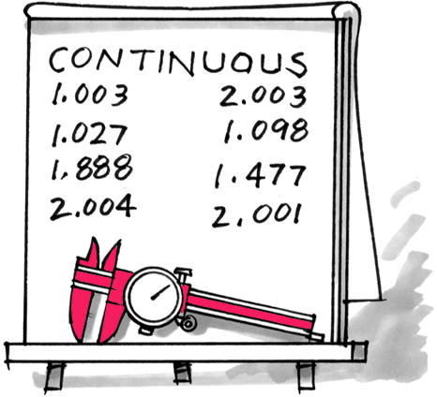
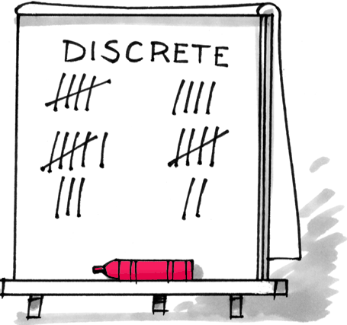
Types of Data
Continuous Data
Discrete Data
•
Often obtained by use of a measuring
•
Includes percentages, counts, attribute,
system.
and ordinal.
–
Percentages = the proportion of items
•
The usefulness of the data depends on
with a given characteristic; need to be
the quality of the measurement system.
able to count both occurrences and
and non-occurrences.
•
Counts of non-rare occurrences are best
–
For count data, it is impossible or
treated as continuous data.
impractical to count a non-occurrence;
the event must be rare.
•
Occurrences must be independent.
Notes:
Tell the participants:
Being continuous means that the data can always be expressed in a smaller unit of measure: e.g.,
miles → feet → inches
months → weeks → days → hours → minutes
With continuous data, the reliability of the measurement instrument is extremely important. You need to know—
Is the measurement system stable?
How accurate is it?
How precise is it?
With count data, its important to know the area of opportunity: the boundaries that define when you’ll start and stop the count. This can be a given time period, a fixed area of product, or a certain number of units.
The occurrences must be relatively rare compared to a relatively large area of opportunity.
Independence is also important for all data. It means that any given measurement or occurrence is not influenced by another measurement or occurrence. For example, a mistake in a subtotal in an expense form will lead to a mistake on the grand total. The grand total mistake is NOT independent of the subtotal mistake.
With count data, you should be looking at rare events. As a rule of thumb, events are considered rare if they happen less than 10% of the time when it’s possible for them to occur. If the event is relatively frequent, treat it as continuous data.

Slide 24
Examples of Data
Type/
How Obtained
Examples
Continuous
Service:
Elapsed time to complete transaction, average length of phone calls
(or “variables”)
Measuring instrument
Manufacturing:
Elapsed cycle time, metal purity, gauge production rates, weight, length, speed
or a calculation
Both:
Budget vs. actual (dollars); average customer satisfaction score; amount purchased
Discrete:
Service:
Proportion of late applications, incorrect invoices
Percentage or
proportion
Manufacturing:
Proportion of defective items, reworked items, damaged items, late shipments
Count occurrences
Both:
Proportion of employees absent, incomplete orders
and non-occurrences
Discrete:
Service:
Number of applications, errors, complaints, etc.
Count
Count occurrences
Manufacturing:
Number of computer malfunctions, machine breakdowns, accidents
in an area of
opportunity
Discrete:
Service:
Type of application, type of request
Attribute
Manufacturing:
Type of product
Observation
Both:
Type of customer, type of method used (new vs. old), location of activity
Discrete:
Both:
Customer rating (1 = very satis/ 5 = very dissatisfied); day of week (MTWTF), date, time order
Ordinal
Observation or
Ranking
Notes:
Tell the participants:
The type of data you have influences which data tools and analytical methods you should use.

Slide 25
Developing a Sampling Scheme
There are many times when collecting all the data from a process isn’t possible.
  There may be too much data, and it would be impractical, too costly, or too time consuming to collect and analyze it all.
  Collecting the data may be destructive (e.g., taste testing) and you need to minimize product loss.
Sampling means collecting only some of the data.
  Statistical methods allow us to make sound conclusions about a process even from a relatively small sample. This is called “statistical inference.”
Notes:
Tell the participants:
Sampling will be discussed in more depth in a later section of this stage.

Slide 26
What Is Sampling and Why Do It?
Sampling is
    Collecting a portion of all the data.
    Using that portion to draw conclusions (make inferences).
Why sample? Because looking at all the data may be
    Too expensive.
    Too time-consuming.
    Destructive (e.g., taste tests).
Sound conclusions can often be drawn from a relatively small amount of data.

Slide 27
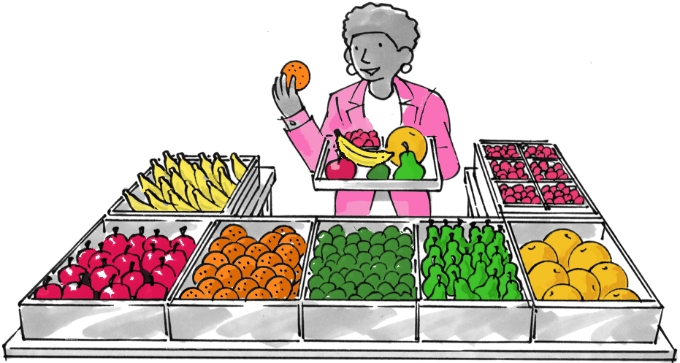
Representative Samples
For conclusions to be valid, samples must be representative.
  Data should fairly represent the population or process
  No systematic differences should exist between the data you collect and the data you don’t collect
Notes:
A representative sample requires planning. Consider:
What groups to sample, and the proportion of each group in the sample
When to sample and/or how often to sample
Where to sample

Slide 28
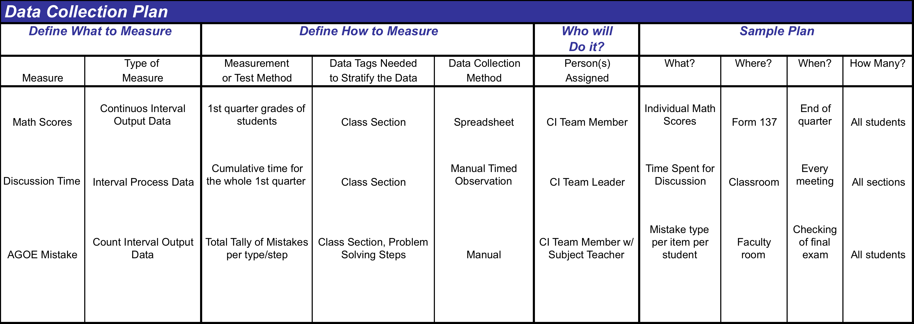
Example: Data Collection Plan

Slide 29
Data Collection Forms

Slide 30
Data Collection Forms
Samples of common data collection forms
Checksheet
Frequency Plot
Report Preparation Confirmation Checksheet
Package Weight
Planned
Completion Data
date
Actual
Planned
Actual
Step
Done?
date
duration
duration
Notes
Project completed
6-12
6-26
N/A
N/A
Cust requested
changes
Client review &
6-17
7-6
5d
10
d
Client personnel
approval
on vacation
Final report, draft
6-30
7-21
13d
15d
Final report review
7
-12
7-28
12d
7d
16.0
16.1
16.2
16.3
16.4
16.5
16.6
16.7
16.8
Final report revisions
7-21
8-2
9d
5d
Minor changes
Weight in ounces
requested
Desktop publishing of
7-28
7d
report
Final report submission
7-30
2d
Tally Sheet
Checkout Line Delays
Concentration Diagram
Cashier
Wendy
Date
May 19
Expense Report
Reason
Frequency
Comments
July 2
94
Price check needed
Name: _____________________ Week ending ___________ 19___
Date
Project
Hotel
Trans
Meals
Misc
Total
Comments
No cashier available
Code
R R R
E E E E E
M M T M
E E E E
R R
R
F
Register out of tape
E
E E E E
R R R
E A
Not enough money
Forgot item
Wrong item
Totals
E E E
E
A E A E
E A E E
E E E E E
Manager assistance
Correct cashier error
E: Entry missing
A E
A E E A
needed
OK check
R: Receipt missing
Other
M: “Misc.” not explained
T: “Trans” no explained
A: Arithmetic error
Notes:
Tally Sheet
Checksheet
Concentration Diagram
Frequency Plot

Slide 31
Checksheet Features
Defines what data
is being collected
Machine Downtime
- Line 13 -
Operator
Wendy
Date
May 19
Reason
Frequency
Comments
Carton Transport
Metal Check
Has room for comments
No Product
Sealing Unit
Lists the characteristics or conditions of interest
Barcoding
Conveyor Belt
Bad Product
Burned Flakes
Low weight
Other
Includes place to put the data
May want to add space
for tracking
stratification factors
Notes:
Tell the participants:
Checksheets are basic forms that help standardize data collection by providing specific spaces where people should record data.
Keep the form simple to use and easy to understand.
Include only the information you intend to use.
Pilot the data collection form—try it out before you use it full scale; make changes as needed.

Slide 32
Collecting Time Data
  Review operational definitions for the starting and ending points of each process step.
  Note down any information observed that is relevant to the time of the process step
  Develop a data collection form
Process Step | Time Start | Time End | Cumulative Time | Notes

Slide 33
Getting Data from a Process
A process is dynamic and ever-changing
Sample systematically or with subgroups (not randomly) across time.
Preserve the time order to represent the process behavior better.
Try to sample from enough time periods to fairly represent the sources of variation in the process.
Apply a consistent interval between samples (every 10th unit, every 7th unit; every day, every month, etc.).
Collect small samples more frequently so that the process trend is captured
Notes:
Systematic or subgroup sampling ensures the sample will be representative of the process because each time period is represented.

Slide 34
Tips of Collecting Data

Slide 35
Tips when collecting data
Have an orientation on gathering data
Do preliminary tests on collection
Measuring device is sufficient to capture accuracy needed
Procedure of collecting data is consistent across all data collectors
Data collected should be consistent in the unit of measure
Process owners and subjects are informed of the data collection

Slide 36
Data Analysis

Slide 37
Data Analysis
Graphical Data Display and Analysis
  - Stratification
- Line Chart
- Histogram
- Histogram Bins
- Pareto Chart
- Scatter Plot

Slide 38
Key Message
The appropriate use of graphical display and analysis tools coupled with the proper treatment of data leads to a clearer and better understanding of the problem to be tackled.

Slide 39
Graphical Data Display & Analysis

Slide 40
Stratification
When data is lumped together the meaning and insight from the data can be clouded or distorted.
WHEN TO STRATIFY:
Before collecting data.
When data come from several sources or conditions, such as classes, days of the week, suppliers or year level groups.
When data analysis may require separating different sources or conditions.

Slide 41
Stratification Procedure
Prior to data collection, consider which information about data source might have an effect on the results. Set up the data collection so that you collect that information as well.
When plotting or graphing the data use different marks or colors to distinguish data from various sources or plot in different panels according to the source.
Analyze the subsets of stratified data separately.

Slide 42
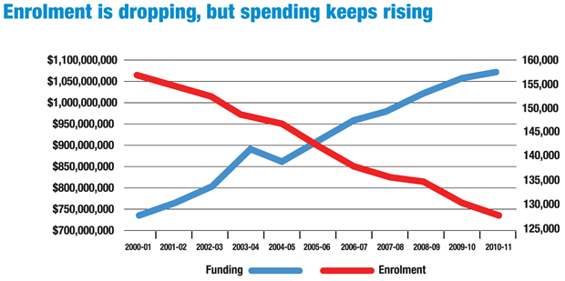
Line Graph
A time plot is a graph of data in time order.
It show trends or patterns over a specified period of time.
Notes:
Tell the participants:
Other use of Line graph.
To focus attention on truly vital changes in the process.
To track useful information for predicting trends.
To understand variation in the process.
To compare a performance measure before and after implementation of a solution to assess the solution’s impact.
To detect trends, shifts, and cycles in the process
STEPS IN DOING LINE CHART
1. Determine the purpose of the chart and the data to be monitored, collected, and analyzed. Select the time interval or an equivalent representation of passage of time (minute, hour, trial sequence, etc).
2. Collect the data that will be plotted.
3. Plot time on the horizontal axis (typically located at the bottom).
4. Label the vertical axis and plot the data collected in step 2 on the vertical axis (typically located on the left-hand-side).
5. Title the chart. Indicating which direction is better with an up or down arrow may be helpful.

Slide 43
Line Graph: Individual Practice Exercise
The following is a 15-year data on drop-out rate for QC division schools. We will use Excel to do a run chart.
Year | Drop-Out Rate
1 | 3.4
2 | 2.3
3 | 2.6
4 | 3.2
5 | 3.5
6 | 3.1
7 | 2.6
8 | 3.5
9 | 3.3
10 | 3.8
11 | 4.2
12 | 4
13 | 3.9
14 | 4.5
15 | 4.2

Slide 44
Disaggregating (Stratifying) the Line Chart
3200
Total Tons of Waste Collected
3000
2800
Tons
2600
2400
2200
Library Tons of Waste Collected
2000
9/91
10/91
10/91
11/91
12/91
1/92
2/92
3/92
4/92
5/92
6/92
7/92
8/92
9/92
10/92
11/92
12/92
1/93
2/93
3/93
4/93
5/93
6/93
7/93
1300
Month
AD-727
1100
Tons
900
700
500
300
9/91
10/91
10/91
11/91
12/91
1/92
2/92
3/92
4/92
5/92
6/92
7/92
8/92
9/92
10/92
11/92
12/92
1/93
2/93
3/93
4/93
5/93
6/93
7/93
Month
Canteen Tons of Waste Collected
1300
Gym Tons of Waste Collected
1300
1100
1100
Tons
900
Tons
900
700
700
500
500
300
300
9/91
10/91
10/91
11/91
12/91
1/92
2/92
3/92
4/92
5/92
6/92
7/92
8/92
9/92
10/92
11/92
12/92
1/93
2/93
3/93
4/93
5/93
6/93
7/93
9/91
10/91
10/91
11/91
12/91
1/92
2/92
3/92
4/92
5/92
6/92
7/92
8/92
9/92
10/92
11/92
12/92
1/93
2/93
3/93
4/93
5/93
6/93
7/93
Month
Month
Notes for Stratified Line Chart:
1. Encode data from each source in separate columns.
2. Highlight multiple columns at the same time. Choose a Line Chart
type. Excel does stratification for the user giving a line plot for each
column or data source.

Slide 45
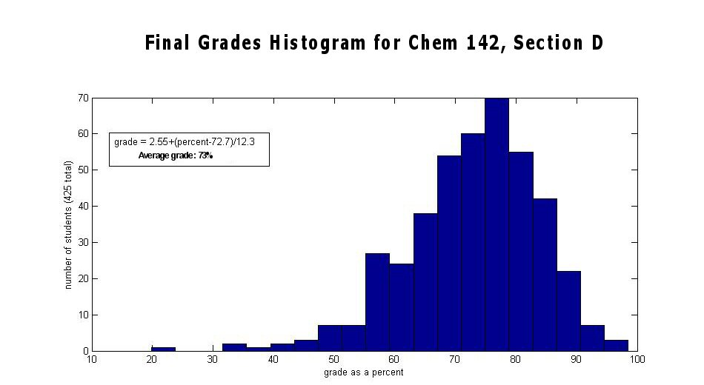
Histogram
A frequency plot shows the shape or distribution of the data by showing how often different values occur.
Notes:
Tell the participants:
Data Pattern where the most frequently occurring value is in the middle and other observations tail off symmetrically in both directions.
STEPS IN DOING HISTOGRAM
1. Organize your data into a table. Create one column for data range categories, divided into
equal intervals that will include all of your data (for example, 0-10, 11-20, 21-30), and another column for frequency or percentage. A guideline on how many number of data range categories one could work with is given as follows:
Number of Data Points: 100 or less, 101 to 200, and 201 or more
Number of Data Range Categories: 7 to 10, 11 to 15, and 13 to 20
2. Create a graph on graph paper. Mark the data range intervals on the x-axis (horizontal axis) with no space between the categories. Mark frequency or percentages on the y-axis (vertical axis), also in equal intervals.
3. Plot your data. For each data range category, draw a horizontal line at the appropriate frequency or percentage marker. Then, create a vertical bar for that category reaching up to the marked frequency or percent. Do this for each data range category.

Slide 46
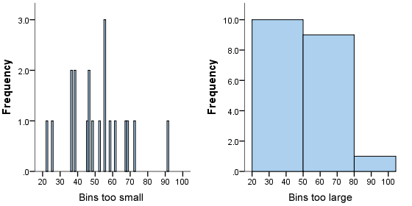
Number of Bins in a Histogram
Too Much Bins
Too Few Bins
Details data too much thus failing to make pertinent patterns immediately obvious
Aggregates data too much thus hiding pertinent patterns that effectively describes data

Slide 47
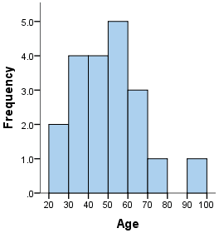
Number of Bins in a Histogram
Right Number of Bins
Tabular Guide on Number of Bins Depending on Number of Data Points
Right Number of Bins Dependent on Number of Data Points
Makes noticeable the center and spread of data in one glance
Data Points | Number of Bins
20-50 | 6
51-100 | 7
101-200 | 8
201-500 | 9
501-1000 | 10
1000+ | 11-20

Slide 48
Histogram Construction Steps
Count the number of data.
Determine the number of bins.
Get the maximum and minimum data value. Compute the difference between the two and divide by number of bins. Call this resulting number as the class width. (Round off to a convenient value.)

Slide 49
Histogram Construction Steps
4. The smallest data is the lower limit of the first bin range. Add class width to this for the lower limit of next bin. Upper limit of a bin is the number before the lower limit of the next bin range. Do this until the maximum value is reached.
5. Count the number of data falling into a bin range and do a bar chart.

Slide 50
Histogram: Individual Practice Exercise
The following are the grades of 100 high school students in their Algebra final exam. Using your Excel build a histogram for this data.

Slide 51
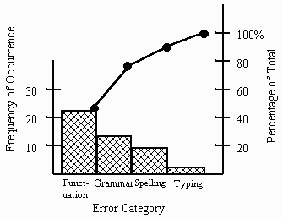
Pareto Chart
The Pareto chart is a frequency distribution (or histogram) of attribute data arranged by category.
Notes:
Plot the frequency of occurrence of each defect type against the various defect types.

Slide 52
Pareto Chart: Individual Practice Exercise
The following are listed reasons as to why students are having problems accessing files in the computer lab. Construct a Pareto Chart for this data using Excel.
Reasons | Frequency
Unable to Download | 50
Can’t Find the File | 30
Open as Read Only | 15
Can’t Change Background | 7
Can’t Open the File | 6
Found a Bug | 5
Can’t save Changes | 4
Don’t Have Excel | 4
Doesn’t Work in OpenOffice | 4

Slide 53
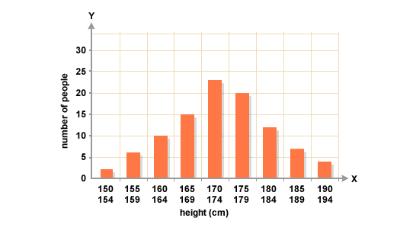
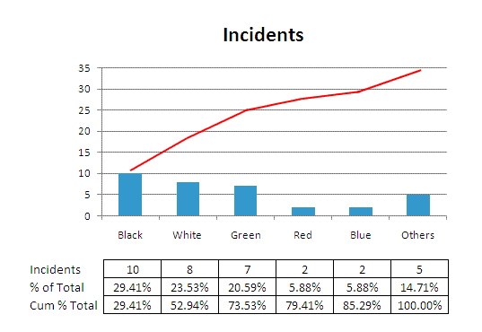
Difference of Histogram & Pareto Chart
Use histogram if data to be tallied is quantitative.
Computation of average, variability and changes over time is possible.
Can be used to display how bad the problem is.
Use pareto chart if data to be tallied is qualitative.
Average and variability computation not possible.
Can be used to display which and where the problem is the greatest.

Slide 54
Scatter Plot
Graphs pairs of numerical data, with one variable on each axis, to look for a relationship between them.
If the variables are correlated, the points will fall along a line or curve. The better the correlation, the tighter the points will hug the line.
Y
X
Notes:
Tell the participants:
When To Use Scatter Plot:
When you have paired numerical data.
When your Y variable may have multiple values for each value of your X variable.
When trying to determine whether the two variables are related, such as when trying to validate potential root causes of problems or whether a particular cause and effect are related.
When determining whether two effects that appear to be related both occur with the same cause.

Slide 55
Scatter Plot: Individual Practice Exercise
In 2 sections in the 4th year level, the final grades of the students in Math and Science were gathered. Construct a scatter plot using Excel.
Section A |  | Section B
Math Scores | Science Scores | Math Scores | Science Scores
84 | 98 | 87 | 75
93 | 84 | 96 | 85
71 | 57 | 74 | 78
81 | 73 | 84 | 76
59 | 71 | 62 | 70
65 | 65 | 68 | 65
48 | 58 | 51 | 60
48 | 38 | 51 | 80
51 | 56 | 54 | 65
47 | 47 | 50 | 75
67 | 80 | 70 | 76
72 | 79 | 75 | 65
95 | 89 | 98 | 82
89 | 85 | 92 | 75
65 | 65 | 68 | 50
78 | 86 | 81 | 53
93 | 95 | 96 | 90
74 | 74 | 77 | 85
93 | 96 | 96 | 82

Slide 56
Some Final Words
Use and take advantage of MS Excel.
Take care to stratify data from collection to analysis.
Scales and categories matter.
Data types dictate the appropriate graphical display tool.

Slide 57
Selecting the Focused Problem Statement

Slide 58

Focused Problem Statement
Objective
  Focus the improvement effort by analyzing the gathered data on the process area
Deliverables
  Focused problem statement
  Data that pinpoints problem
http://us.123rf.com/400wm/400/400/chudtsankov/chudtsankov1202/chudtsankov120200196/12493294-detective-dog-holding-a-magnifying-glass.jpg

Slide 59
Link to walk the process
The team has a detailed process map of the process for improvement
The team has identified storm clouds in the details steps of the process for improvement
Identified relevant measures on storm clouds items
The team has developed a data collection plan

Slide 60
What is a Focused Problem Statement
Problem statements that pertain to a specific component only
Problem statements that include information about the following questions
    What is the problem, and how often is it happening
    Where is it happening
    Who is engaged in the behavior
    When the problem is most likely

Slide 61
The Focused Problem Definition
SHALLOW
"An Inch Wide and a Mile Deep"
Quality not quantity
Depth of Analysis
DEEP
FEW
Problems Dealt With
MANY
Notes:
Tell the participants:
More helpful to fix attention at a specific component of a problem
Makes it easier to identify causes and take corrective action thus time and resources are used in a more effective manner
Should answer- what (the object and the defect), where, when, who and how big

Slide 62
Focusing a Problem Definition
The canteen service is poor.
Broad or vague
Somewhat focused
Narrow focus
What: Poor service
The cashier service of the canteen is taking too long.
Broad or vague
Somewhat focused
Narrow focus
What: Poor Service
What type of service: Cashier service
What about the service: It is too long.
Monitoring last Jan. 2014 showed that the cashier service of the canteen during class recess during Mondays takes 30 minutes to finish, versus the standard of 15 minutes.
Broad or vague
Somewhat focused
Narrow focus
What: Poor Service
What type of service: Cashier service
What about the service: It is too long.
How long: 30 minutes
What is the standard: 15 minutes
When is this problem the greatest: Recess time. on Mondays
When was this observed: Jan. 2014

Slide 63
Practice: Focused Problem Statements
Scenario | Broad and Vague | Narrow Focus
Student Counseling
Student Grade Computation
Attendance Monitoring
Counseling takes a long time
Pre-counseling activities takes 2x longer than the actual counseling for students with offenses
Wrong computation of grades
All the 2nd yr students are complaining that their final grade in English this 2nd qrtr is erroneously low
Attendance is not accurate
Attendance records are not accurate for Section A during the first 3 weeks of the month
Notes:
Ask the participants:
Convert the broad and vague problem statements to one with a narrow focus.

Slide 64

Selecting the Focused Problem Statement among Storm Clouds
Which one should you focus on?
Issue 1
Issue 2
Issue 4
Issue 3
Issue 5

Slide 65
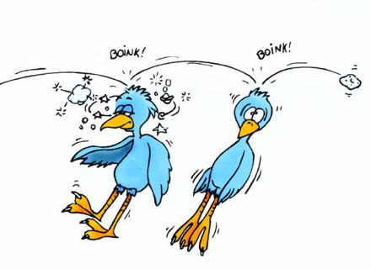
Relationship of Storm Clouds
A Storm cloud may have an effect on another storm cloud
Storm clouds that have an effect on another storm cloud have a causal relationship with the other storm cloud
http://2.bp.blogspot.com/_Hr-M9Z6sYJo/THShTKKDfFI/AAAAAAAAA0Y/NcGXciWOYqA/s640/2%2Bbirds%2B1%2Bstone.jpg

Slide 66
Storm Clouds with Causal Relationship
Absences
Students Failed in Math
Student Health
Absences
Teaching Time Spent in Class
?
Mean Percentage Scores of Class
Notes:
Tell the participants:
The correlation and scatter plots can be used to determine causal relationships

Slide 67
Causal Relationship Example
School Measure: Low number of passing students in Math for the Grade Level
Issue 3
Check Attendance
Do Motivation Activities
Review Previous Lesson
Lecture on Current Lesson
Assess Student Mastery
Give Homework
Issue 1
Issue 2
Issue 4
Issue 1: Most students are not participating in the class discussion.
Issue 2: Students can not see the writing on the black board
Issue 3: The class is not paying attention
Issue 4: Only 20 out of 60 students have a passing average (60% passing rate) for the past three summative tests

Slide 68
Causal Relationship Example Continued
Scenario 1
Scenario 2
Issue 1
Issue 1
Issue 4
Issue 4
Issue 3
Issue 3
Issue 2
Issue 2
Issue 1: Most students are not participating in the class discussion.
Issue 2: Students can not see the writing on the black board
Issue 3: The class is not paying attention
Issue 4: Only 20 out of 60 students have a passing average (60% passing rate) for the past three summative tests

Slide 69
Key Message
The Focused Problem makes it easier to identify causes and take corrective action by identifying the critical storm clouds

Slide 70
Situating the Storm Clouds Example
Poor Classroom Structure
Overlooked Test Results Analysis
Inappropriate Ready-made Lesson Plans
Prepare Lesson Plan
Update/
Improve Instructional Materials
Set Classroom Environment
Deliver Instructions (Reading Lessons)
Evaluate Pupils
Extra effort
Not geared to the enhanced curriculum

Slide 71
Broad and Vague | Narrow Focus
Inappropriate Ready made lesson plans
Poor Classroom structure
Overlooked Test Results Analysis
Notes:
Ask the participants:
Create problem statements with a narrow focus based on the broad and vague problem statements

Slide 72
Broad and Vague | Narrow Focus
Extra Effort
Not geared to the enhanced curriculum

Slide 73
Example: Focused Problem Statement
Preparing of Lesson takes extra effort from the teacher because of the time it takes 60 – 90 minutes which is more than the desired time of 30 – 45 mins.
Formulate Objective for class
(3-5 minutes)
Prepare materials
(5-10 minutes)
Make Review, Drill, Motivate
(3-5 minutes)
Design Lesson Delivery
(10-15 minutes)
Preparation of Materials for Assessing Student Mastery(10-15 minutes)
Design Home activities
(3-5 minutes)

Slide 74
Activity

Slide 75
Exercise: Data Analysis on Math Teaching Learning Process
A particular CI team was tasked to study its student performance in Math. The subject of the study was the Grade 4 level composed of 3 sections (the school only had a small population).
At the end of the 1st grading, the grade score (Math Score column) of the students were obtained. The 1st grading exam was analyzed for the purpose of counting and classifying the student mistakes (Count & Classification of Mistakes).

Slide 76
Exercise: Data Analysis on Math Teaching Process
It was also of interest for the CI team to know whether conduct of classes and related processes to teaching math has an impact on the student’s performance on the subject. As such data on time spent by teacher in discussing the concept and principles (Discussion Time) throughout the grading period, student comprehension ability (English Score) and attendance (Number of Absences) were also obtained.

Slide 77
Exercise: Data Analysis on Math Teaching Learning Process
Objective:
Using the graphical data display techniques, analyze the data to identify which among the storm clouds listed below will be the focused problem statement.
Guide Questions:
Does Math performance vary across sections?
Do students perform all types of mistakes equally? If not, what type of mistake would be the most urgent to address at this stage?
Is there any reason to consider or link discussion time to the students’ Math performance?
Would it be fitting to look into the English teaching and learning practices of the school as far as it relates to Math?
What is the link between students’ capacity to do basic operations and their Math performance?

Slide 78
Case: Defining the Focused Problem Statement
The Process Map for Problem Solving is provided in the next slide. The Process Map also includes some identified storm clouds.
Using this information and additional data given in the succeeding slides, craft the Focused Problem Statement.

Slide 79
PROCESS MAP in PROBLEM SOLVING
INCONSISTENT DISCUSSION TIME
CAN’T PERFORM BASIC OPERATION
GIVING MORE EXAMPLES
PROBLEM SOLVING SELECTION
TEST ON PROBLEM SOLVING
DISCUSSION
CANNOT COMPLETE AGONA
CORRECTLY
RE-TEST AND FEEDBACK
FEEDBACK ON TEST RESULT
CHECK ON THE ANSWER

Slide 80
Broad and Vague | Narrow Focus
Inconsistent Discussion Time
Can not perform basic operation
Can not complete AGONA correctly

Slide 81
1- 8 Read and write whole numbers
9 - 10 Place Value
11 – 30 Add,
Subtract, Multiply, Divide Whole Numbers
31 – 32 Problem Solving
Notes:
Analysis:
Item numbers 31 and 32 got the lowest score consisting of problem solving so another set of problems were given to determine their ability.

Slide 82
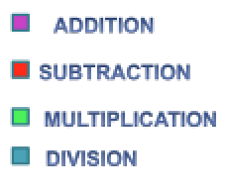
Notes:
Analysis:
Item numbers involving multiplication and division processes got the lowest scores. So another 3 sets of problems were given to the pupils to decide what operation

Slide 83
Notes:
Analysis:
This graph shows that pupils have difficulty in answering problem # 1 which involved division of whole numbers with 3 digits divisor
Focused Problem Statement:
96% of Grade IV pupils of are Non-numerates. They cannot complete the AGONA Method in Solving Word Problems with division.

Slide 84
SIPOC
( Current State)

Slide 85
“A problem correctly stated is a problem half solve”

Slide 86
GOD BESS!!
THANK YOU
Juliet-Mabinay NHS
Team Leader

