Slide 1
Step 6: Generating Solutions
Stage 2: Analyze
Notes:
RECAP the previous step.
TELL the participants:
In this unit, our learning objectives are:
Understanding basic concepts on solution generation and development.
Being able to generate and select from alternative solutions

Slide 2
Learning Objectives
Understand basic concepts on solution generation and development.
Be able to generate and select from alternative solutions.

Slide 3
Analyze – Steps
Do Root Cause Analysis
Develop Solutions
Finalize Improvement Plans
Root Cause Analysis
Common Mistakes in Root Cause Analysis
Types of Root Cause Analysis
Validation of Root Causes
Process Simplification
Visual Management
Good Housekeeping
Mistake Proofing
Idea Generation Technique
Future Process Map
Implementation Plan
Budget and Cost Management Plan
Resource Plan
Risk Management
Notes:
Tell the participants:
Use data and process information to help identify possible causes of the problem.
Develop practical and relevant solutions
Craft an improvement plan in preparation for piloting.

Slide 4
Key Message
A set of principles or concepts should be used to generate solutions for the root causes of the problem.

Slide 5
Outline
Process Simplification
Visual Management
Good Housekeeping
Mistake Proofing
Idea Generation Technique
Future Process Map
Notes:
SHOW the outline slide.

Slide 6
Process Simplification
Notes:
INTRODUCE Process Simplification.

Slide 7
What is Process Simplification?
An activity that involves breaking down the process into smaller task
Classifying each task whether it is necessary, redundant or wasteful.
7
Notes:
TELL the participants:
Process Simplification is a process design technique that allows us to make a process more manageable by dividing it into relatively simple tasks. Every task is then carefully observed to detect and remove redundant or wasteful actions. It also allows us to estimate the precise time necessary for implementing corrections.
This technique aims to design and plan a process in a manner that is least expensive and consistent with the process’s objectives.

Slide 8
Objective of Simplification
Eliminate wasteful or non-value adding actions
Reduce process cycle time
Remove defects or disconnections between process tasks
Increase employee involvement
Reduce process cost
8
Notes:
TELL the participants:
The simplification of a process allows us to reach greater productivity through the reduced use of mental and/or physical employee effort. Productivity improvements also result from the minimization of money and time involved in the process. Employees do more simplified jobs with greater performance through simplification and continuous improvement.
Meanwhile, the process remains true to its original objectives. Only the process’s structure and resources are changed in order to reach

Slide 9
Components of an Activity
Activity
Value Adding (5%)
Necessary but non Value Adding (35%)
Non Value Adding (60%)
9
Notes:
Tell the participants:
Customer Value: A task or activity for which the customer would be willing to pay.
Business Value: A task that is required to build a window but for which the customer is not willing to pay.
Non-Value Add (WASTE): A task that is not required and should be eliminated.

Slide 10
Value Adding Activities
Value adding activities should meet three criteria:
The customer must be willing to pay
The activity must transform the product or service in some way
The activity must be done correctly the first time
10
Notes:
TELL the participants:
Customers define what is of value in your value creation process.

Slide 11
Non Value Adding Activities
It is not essential to produce an output or render the service.
11
Notes:
Activities that do not add value to the output or the service may include:
Defects, errors, omissions
Preparation/ setup, control/ inspection
Over-production, processing, inventory
Transporting, motion, waiting, delay
Some tasks, especially those with business values like inspection, are necessary but not directly of value to the customer. The challenge is how to inspect without having to "inspect" (hint: suggest poke yoke or mistake proofing which are topics to be discussed later).

Slide 12
Samples of VA and NVA
Value-Added Activities
Nonvalue-Added Activities
Discussion of lessons
Evaluation of students
Recitation
Writing the lesson plan
Entering order
Ordering materials
Preparing drawing
Assembling
Legally mandated testing
Packaging
Shipping to customer
Waiting
Storing
Counting
Recording
Obtaining Approvals
Reviewing
Copying
Filing
Revising/Reworking
Tracking/Roll-call of attendance
Calling the attention of
noisy students

Slide 13
Visual Management
Notes:
INTRODUCE Visual Management.

Slide 14
4 Principles of Visual System
Know what is Happening
Know what to do next
Know how to do the work
Know how well work was done
14
Notes:
ASK the participants:
What does it mean for a control to be visual?

Slide 15
Know WHAT IS HAPPENING
How do you have line of sight
15
Notes:
DISCUSS the principles of visual management and SHOW the examples.

Slide 16
How to see what is happening
Close proximity with no walls or enclosures separating the linked operations
Implementation of cells
Reconfiguration of capital equipment
Removal of shelves, cabinets, etc…which obstruct view
Physically marking the product path
Signals
Kanban
Andon
16

Slide 17
Office Cell Layout

Slide 18
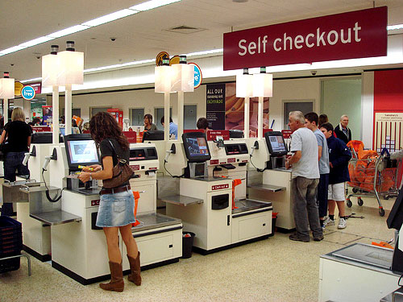
Signal: Andon
18
Notes:
Tell the participants:
The lights at the grocery counters lights up when a problem with the checkout counter happens.
“ANDON” refers to a Japanese word that means a status display station.

Slide 19
Know what to do next
How do you communicate scheduling

Slide 20
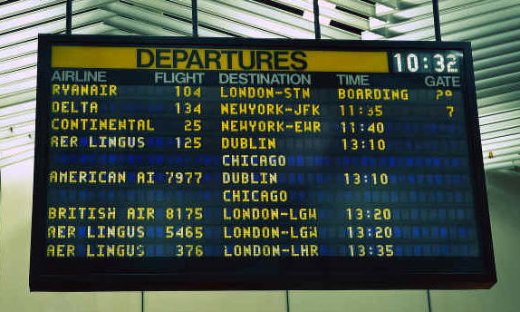
Communicate Scheduling: Visual Scheduling
A second basic aspect of the visual management is utilizing visual tools to communicate scheduling requirements.
20
Notes:
Tell the participants:
These would include:
Physical Kanbans – Kanban is a japanese word for “signs”. It functions as a signal that an action in needed to be performed.
FIFO lanes for incoming materials
Demarcated areas for Buffer storage
Schedule boards
Kanban boards – Kanban boards functions as a scheduling board where any completed task is placed for the other people to know what to do next.

Slide 21
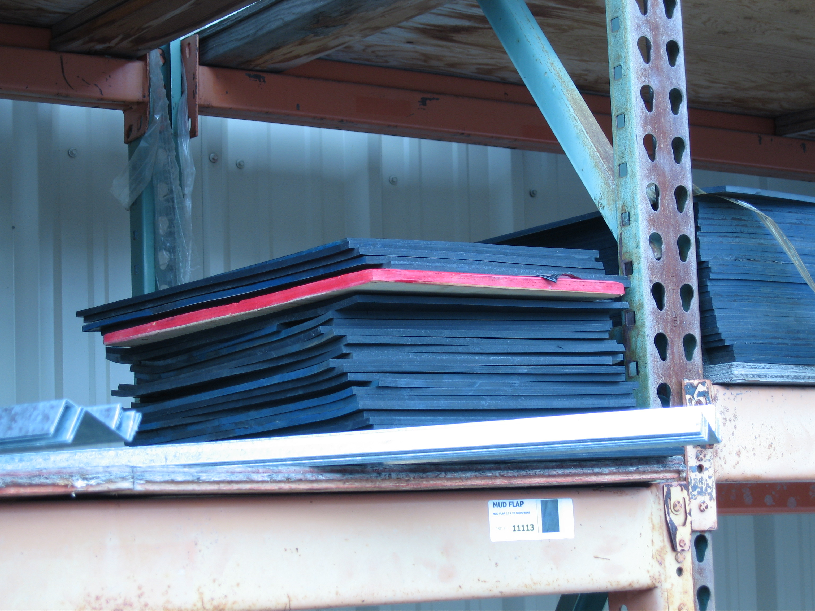
Visual Replenishment

Slide 22
Know how to do work
How do I do it the same everytime

Slide 23
Visual Standard Work
Makes use of job aids (or others) in communicating the required activity sequence, quality requirements, or processes
23
Notes:
Tell the participants:
The current status of a specific operation
These would include:
One Right Way visual documentation
Photographic job aids
Shadow Boards for tools
5 S applications
Andon Lights

Slide 24
Photographic Job Aids

Slide 25
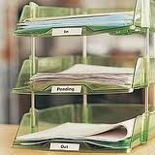
In and Out Box for Identifying Work

Slide 26
Visual Tools for Standard Work
Border – Sets boundaries, areas
Home Address – Defines what item belongs inside the border
Label – Defines what the item is and where it belongs

Slide 27
Border
A line around an item to identify its area/boundaries.
Traffic lanes
Stationary items
Mobile items
Walkways
Tool Outlines
Hazardous Areas

Slide 28
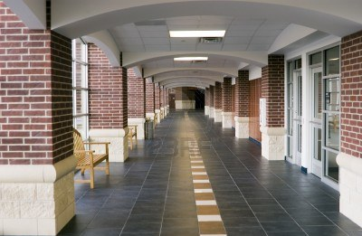
Using Lanes in School Hallways

Slide 29
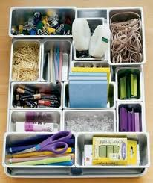
Supply Arranger for the drawer

Slide 30
Shadow Board: Home Address
A sign at the item’s home. It should include:
Item name
Location
Picture/silhouette of item (opt.)
Scissors
Bin A

Slide 31
Shadow Board for Office Supplies

Slide 32
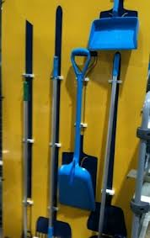
Shadow Board for Cleaning Instruments

Slide 33
Know how well work was done
How to communicate performance measures

Slide 34
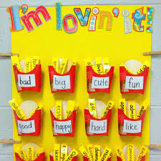
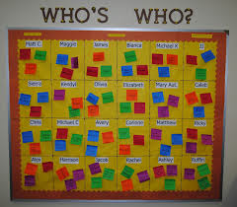
Communicate Performance Measures
The most common visual aid is the posting of performance measures at different levels of the school environment.
34
Notes:
SHOW the tools and TELL the participants:
These tools can be used to communicate performances ranging from an individual operation to the business in total.

Slide 35
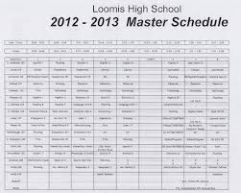
Class Scheduling Boards
Display regular class and school performance targets and achievements
Targets taken from students and class schedules

Slide 36
Visual Advantages
Information is readily available to everyone
Failure is not to be feared, honest performance is displayed
Individuals can see the effect of their contribution to the team's performance. Within their team they can work on improvements
Competition is encouraged
Clear, unambiguous displays aid communication
36
Notes:
TELL the participants:
Clear performance visibility allows the synchronization of all departments to achieve a common goal.

Slide 37
Visual Controls
To be effective visuals must be:
Open, Honest and Relevant
Clear and Simple
Displayed Close to the Area Concerned
37
Notes:
17
Tell the participants:
The Response or Reaction to a Negative Display must be defined and corrective actions must be identified.
Visual displays should regularly be updated with realistic targets.
Visuals which do not adhere to the characteristics mentioned can have a more negative impact than traditional reports.

Slide 38
Pitfalls Visual Control Systems
Irrelevant or complex reporting system and measurement
No signals in the school or classroom
Limited understanding by teachers and students of how things are done or how problems are identified
No visible use of visible real time or short term school or classroom measures
Classroom information not timely. React too late to problems
The actual activity is difficult to see.

Slide 39
5S or Good housekeeping
Review:
Notes:
INTRODUCE 5S.

Slide 40
What Is 5S?
Step 1 SEIRI (SORT) Segregate and Eliminate
Segregate necessary items from unnecessary items and eliminate what is not needed.
Dispose all unnecessary items.
Step 2 SEITON (SET IN ORDER) Arrange and Identify
Arrange remaining items so that they can be found quickly by anybody.
Standardize the locations so that items can easily be located and accessed by anybody.
Step 3 SEISO (SHINE) Daily Cleanup Process
Create a spotless workplace…swept and clean.
Keep equipment and work are clean
Notes:
DISCUSS each 5S step.

Slide 41
What Is 5S?
Step 4
SEIKETSU (STANDARDIZE)
Constant Adherence to the First Three Steps & Safety
Standardize cleanup activities so that these actions are specific and easy to perform.
Create a system to maintain order and a safe work environment.
Ensure compliance to procedures by conducting regular daily exercise.
This is the condition we support when we maintain the first three steps.

Slide 42
What Is 5S?
Step 5
SHITSUKI (SUSTAIN)
Motivate to Achieve Habitual Compliance
Promote adherence to maintaining a high performance, high quality and safe work environment.
Use visual performance measurement tools.
Make a habit of maintaining established procedures and ensuring they are followed.
Create discipline to maintain cleanliness and find ways to enhance/improve the process.

Slide 43
5S or Good Housekeeping
Provides ways to:
Remove all unnecessary and unimportant materials.
Prevent accumulation of unnecessary and unimportant materials.
Organize needed and important materials.
Minimize search and wasted time.

Slide 44
Mistake Proofing (Poka-Yoke)
Review:
Notes:
INTRODUCE Mistake Proofing.

Slide 45
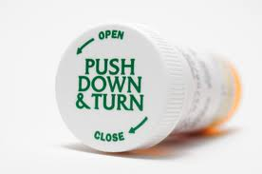
Mistake Proofing (Poka Yoke)
Poka Yoke = error proofing
It is something in a product, process, or procedure that physically or procedurally prevents a person from doing something incorrectly.
45
Notes:
DISCUSS the errors which can be avoided by mistake proofing, and SHOW the examples.

Slide 46
Different Kinds of Errors
Forgetfulness
Misunderstanding
Misidentification
Inexperience
Willful
Inadvertent
Judgment
No standards
Unexpected situations
Intentional

Slide 47
Sources of Errors in Education
Omitted answers
Calculation errors
Errors in setting up work pieces
Missing materials
Wrong experimental method
Processing wrong workplace
Misoperation
Adjustment error
Equipment not set up properly
Tools and jigs improperly prepared

Slide 48
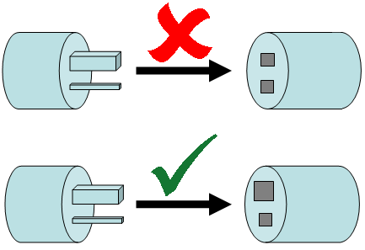
Mistake Proofing our Electric Sockets

Slide 49
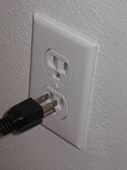
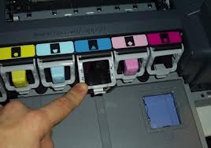
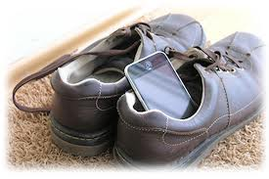
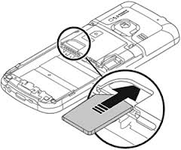
Practical Mistake Proofing Solutions
49
Notes:
Tell the participants:
The use of experience, wisdom and ingenuity to remove opportunities for errors.
Can involve adding a simple feature, changing operation sequence or dynamic reminders that eliminate or substantially reduce mistakes.
Can you tell what the pictures are trying to mistake proof?

Slide 50
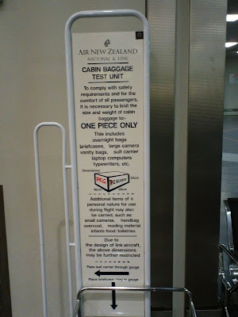
Avoiding Excess Hand Carry Size in Airlines

Slide 51
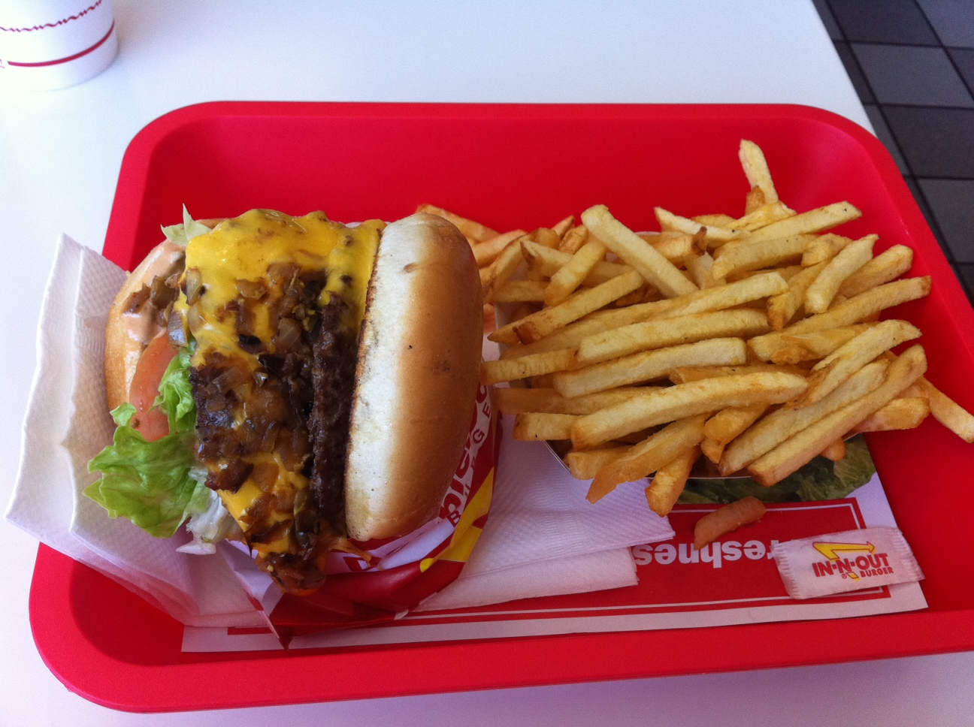
Disposal Bin Poka Yoke

Slide 52
Summary
Simple
(Does not require continuous attention from the operator (ideally, it should work even if the operator is not aware of it)
Inexpensive
Immediate feedback
Corrective action
52
Notes:
EMPHASIZE that solutions need not be expensive or complicated.

Slide 53
Idea generation techniques
Generating Solutions
Notes:
INTRODUCE Idea Generation.

Slide 54
Generating Solution Ideas
Review what you know about the process and the verified cause.
Brainstorm solution ideas; use creativity techniques.
Combine ideas into solutions.

Slide 55
Creativity Techniques
Quick and Dirty
Think Like a Kid
Challenge the Rules
Set a Deadline
Get Rid of Excuses
Short Time Investment
Candid Comments
Musical Chairs
Edison
55
Notes:
TELL the participants:
Quick and Dirty
Think Like a Kid: Imagine what a six-year-old would do when faced with your challenge.
Challenge the Rules: Come up with a list of rules or corporate paradigms. Break the rules.
Set a Deadline: Give yourself five minutes to develop a solution that you have to stick with.
Get Rid of Excuses: List and then work on removing barriers to success
Short Time Investment
Candid Comments: Catch people on location while they’re involved with your area of inquiry. Take notes on what works for them and what doesn’t, what advice they have for solving the problem, what they think would make your process better, or what they think would make your process less of a pain in the neck, more memorable, or more fun. Follow up every observation with a series of questions-- who, what, where, when, how, and, most definitely, why.
Musical Chairs: Look at your challenge from a different perspective, from someone else's vantage point. Start with someone who has no understanding of your task. How would they see your task? How would they react at first blush? Where would they look for answers? What would their concerns be?
Edison: Explore external factors that can influence your task and identify the elements of the larger world that your task is a part of. Create a diagram involving the forces, factors, requirements, constraints, and elements at work around your task. Once your system is complete and balanced, make a dramatic change to one of the forces acting on your system, creating chaos. To return to balance, modify or remove the constraints on other forces to create a new system.

Slide 56
Building on Creative Ideas
Lie to
Make them partners
Parents
Far-fetched
Kernel of
Threshold of
Good idea—
Perfect idea
idea
something
acceptability
could
useful
implement
Stop
Encourage more questions
answering
the questions
Far-fetched
Kernel of
Threshold of
Good idea—
Perfect idea
idea
something
acceptability
could
useful
implement

Slide 57
PRIORITIZING ROOT CAUSES
PRIORITIZED ROOT CAUSES |  |  | SOLUTIONS
People:
 | Student | -Poor comprehension and retention -Basic mathematical operations not mastered | Remediation
 | Teacher | Less Training and exposure | Coaching/ mentoring
 | Parent |  | Regular Parent-Teachers Conference
Procedure:
 | Less Manipulative and engaging activities |  | Coaching/mentoring
 | No ICT-based activities |  | Coaching/mentoring
Instructional Materials:
 | Instructional materials not attractive / inappropriate to students' learning style | not exposed to trainings in the preparation of updated instructional materials | Train teachers
Equipment:
 | Insufficient no. of LCD projectors |  | Ask financial assistance from the PTA
Environment:
 | Classroom not well-ventilated |  | Enhance classroom structuring
 | Classroom size is substandard

Slide 58
ACTIVITY:
Time: 20 minutes
For each of the root cause identified from step 5, develop solutions using any of the four principles of visual management.
- Know what is happening
- Know what to do next
- Know how to do the work
- Know how well work was done
FORMAT:
Develop Solution
Focus Problem Statement:
ROOT CAUSE | SOLUTIONS
Notes:
DISCUSS the future state map and how it relates to the current state map.

Slide 59
Future Process Map
Notes:
DISCUSS the future state map and how it relates to the current state map.

Slide 60
What is a Future State Map?
A process map which includes the changes or the improvements implemented in the process.

Slide 61
Comparing the Current Process Map and Future Process Map
To have a basis of explaining and highlighting the changes in the process:
What the changes will be?
How the changes will be implemented?

Slide 62
Example of Current vs. Future Process Map
Teacher comes to class
C
U
R
R
E N
T
M
A
P
F
U
T
U
R
E
M
A
P
Teacher comes to class
Teacher erases blackboard content
Teacher posts visual aid on the blackboard
Teacher writes discussion notes on the blackboard
Teacher starts discussion of lesson
Teacher starts discussion of lesson
Notes:
Tell the participants:
Comparing before and after maps

Slide 63
Activity:
Work as a team and map out your future process using SIPOC.

Slide 64
“The important thing about a problem is not its solution, but the strength we gain in finding the solution.”

